Slide 1
Introduction to SPARC Core Upgrade
Note: this deck is not an introduction to SPARC and OPS processes. It is designed specifically for campaign managers and marketing staff with SPARC experience dating prior to April 2018.

Slide 2
Create Campaign

Slide 3
Create Campaign Request remains the same, either from the SPARC dropdown menu or from the homepage.
Notes:
- Create Campaign Request remains the same, either from the SPARC dropdown menu or from the homepage.

Slide 4
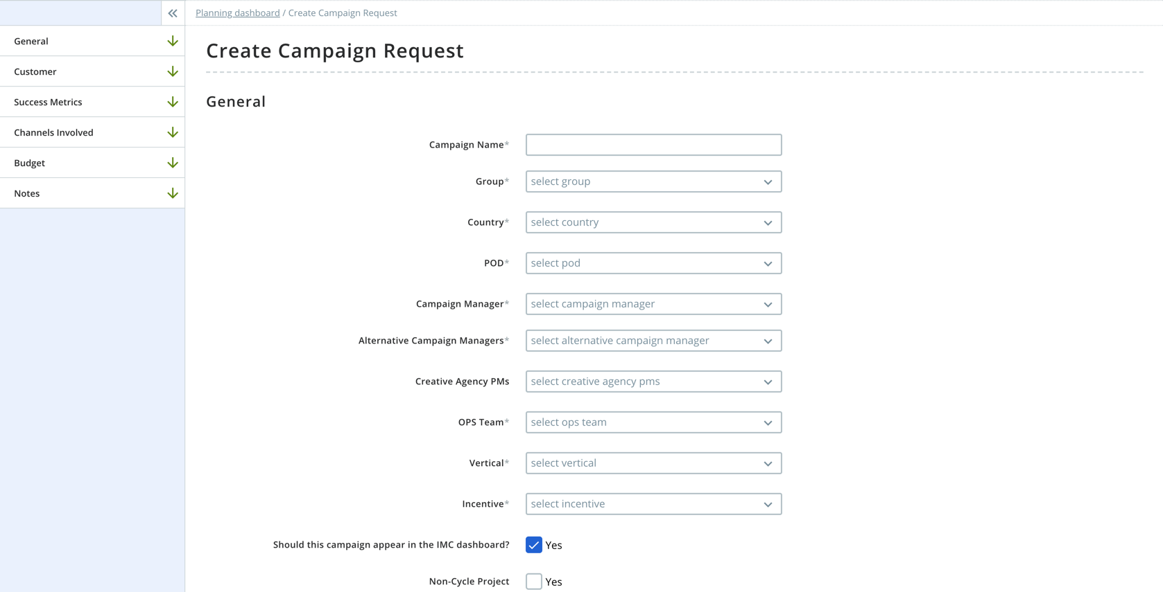
New Navigation on the left hand side bar, clicking on the section takes a user to that section of the request.
Alternative Campaign Managers is replacing Creative Manager & Alternative Approvers.
Edited in Planning → doesn’t cause a change request
Creative Agency PMs to write through to the Creative Request in the future.
IMC Dashboard is auto selected.
Non-Cycle project should be edited by planners only.
Notes:
General Section
New Navigation on the left hand side bar, clicking on the section takes a user to that section of the request.
Alternative Campaign Managers replacing Creative Manager & Alternative Approvers. Edited in Planning, doesn’t cause a change request
Creative Agency PMs to write through to the Creative Request in the future.
IMC Dashboard auto selected.
Non-Cycle project should be edited by planners only.

Slide 5
Customer & Success Metrics: same as previous iteration of SPARC.
Notes:
Customer & Success Metrics
- Stay the same as the previous iteration of SPARC.

Slide 6
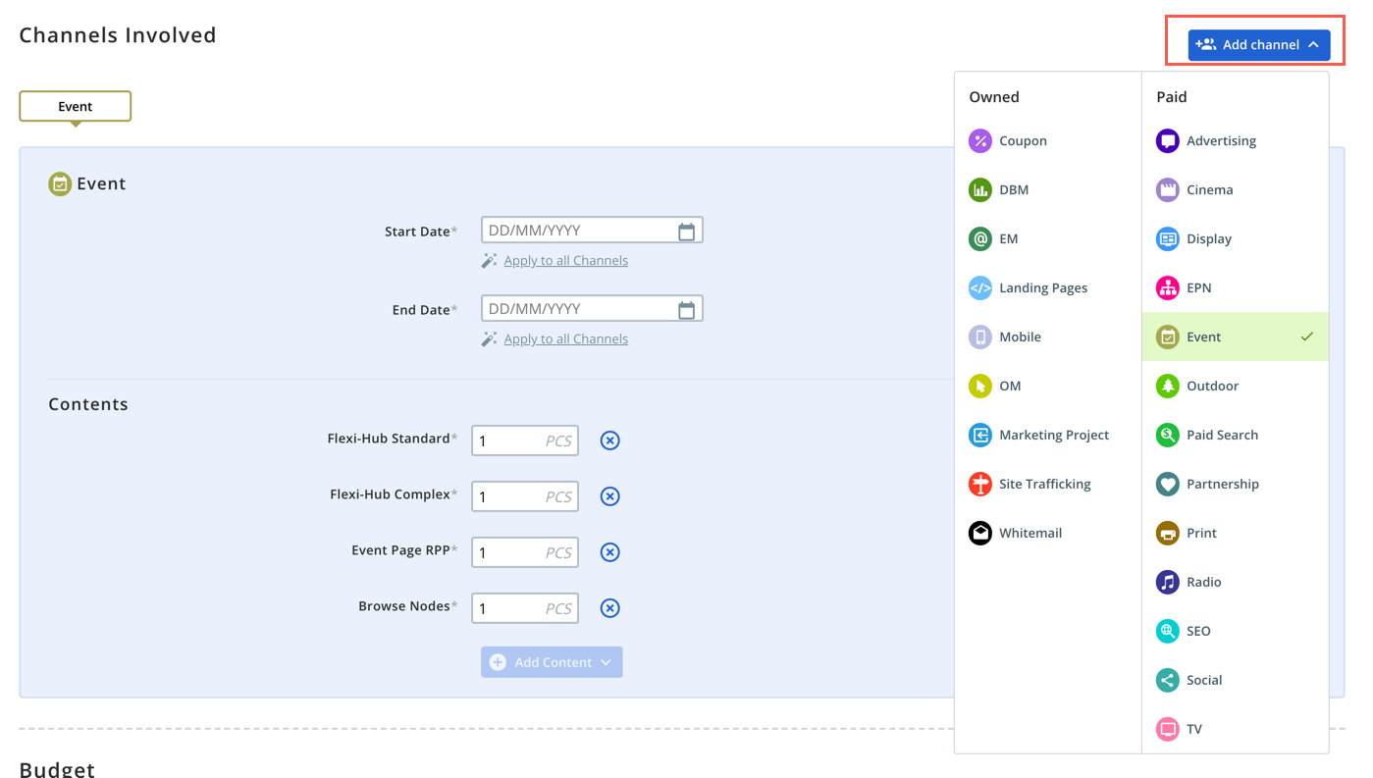
Add Channel: menu is now separated by Owned and Paid channels.
Notes:
Add Channel Menu
- Newly separated by owned & paid channels.

Slide 7
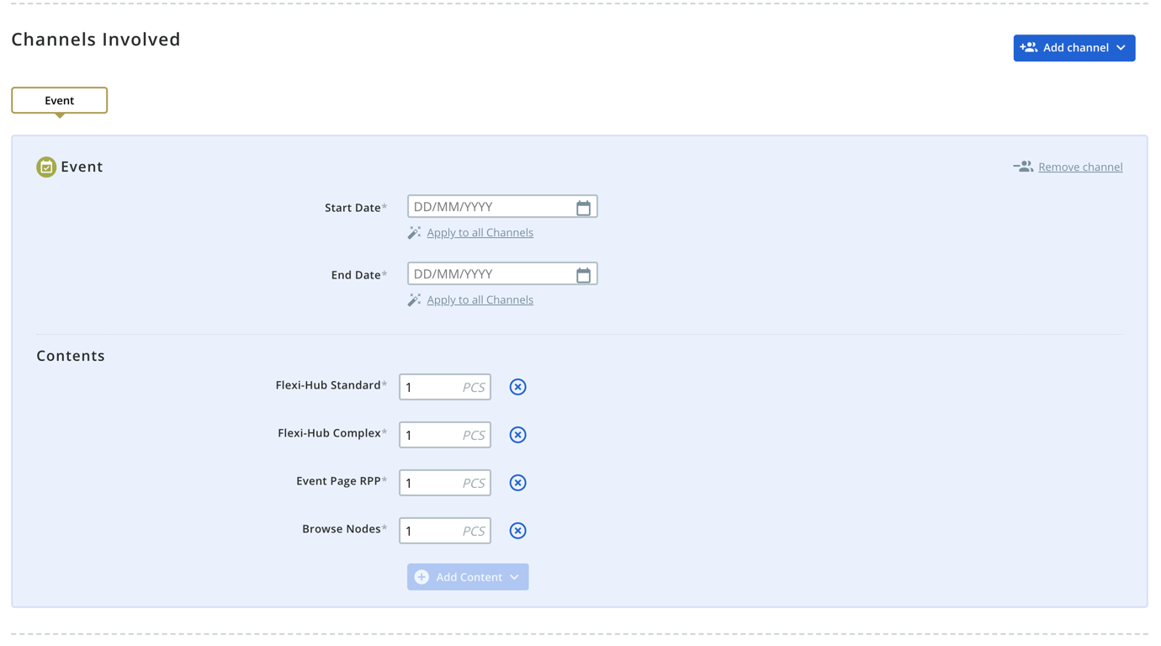
start date and end date on any channel can be applied to all channels with a click
New: Remove channel button
Add contents at the bottom of the channel as a dropdown menu with editable values.
Notes:
New Channel View
Remove channel button on the right hand side
For both start date and end date on any channel the option to apply to all channels
Add contents at the bottom of the channel as a dropdown menu with editable values.

Slide 8
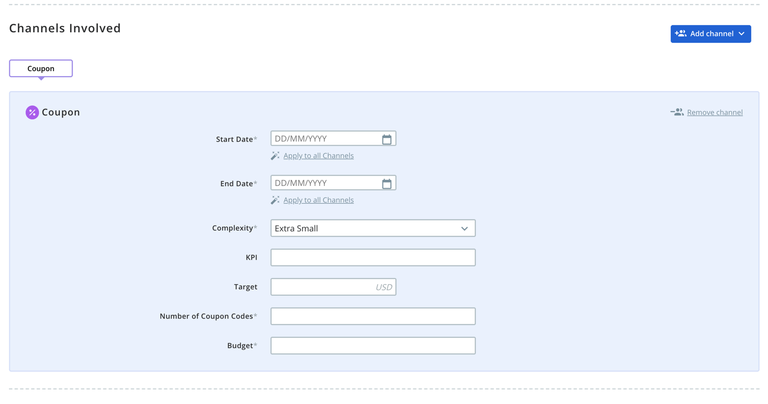
New: complexity dropdown menu selected by the campaign manager
New: Number of Coupon Codes either New or Reused
Coupon Codes are not the same as the audience size. It‘s the number of separate discounts being created.
Notes:
Coupon
- New complexity dropdown menu selected by the campaign manager
New Number of Coupon Codes either New or Reused
Coupon Codes are not the same as the audience size. It‘s the number of separate discounts being created.

Slide 9
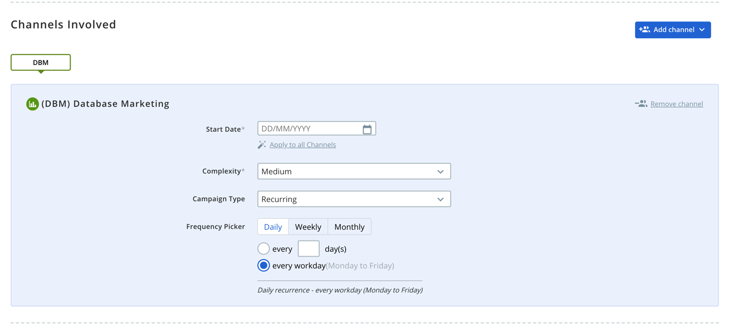
DBM: same as previous iteration of SPARC.
Notes:
DBM
- Stays the same as previous iteration

Slide 10
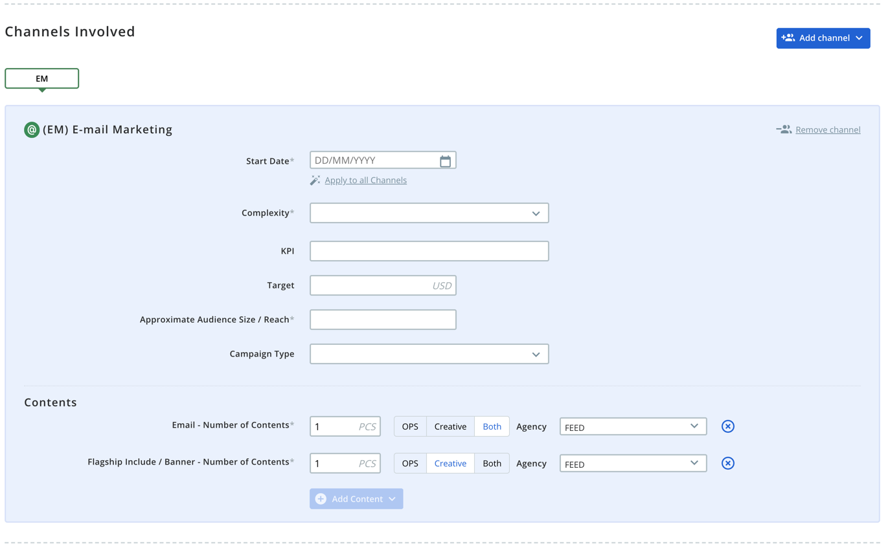
OPS, Creative, or Both selection per asset type
New add content menu
Agency selection to be written through to creative brief in the future.
Flagship include / banner – Number of contents should always be creative only.
Notes:
EM
New add content menu
OPS, Creative, or Both selection per asset type
Agency selection to be written through to creative brief in the future.
Flagship include / banner – Number of contents should always be creative only.

Slide 11
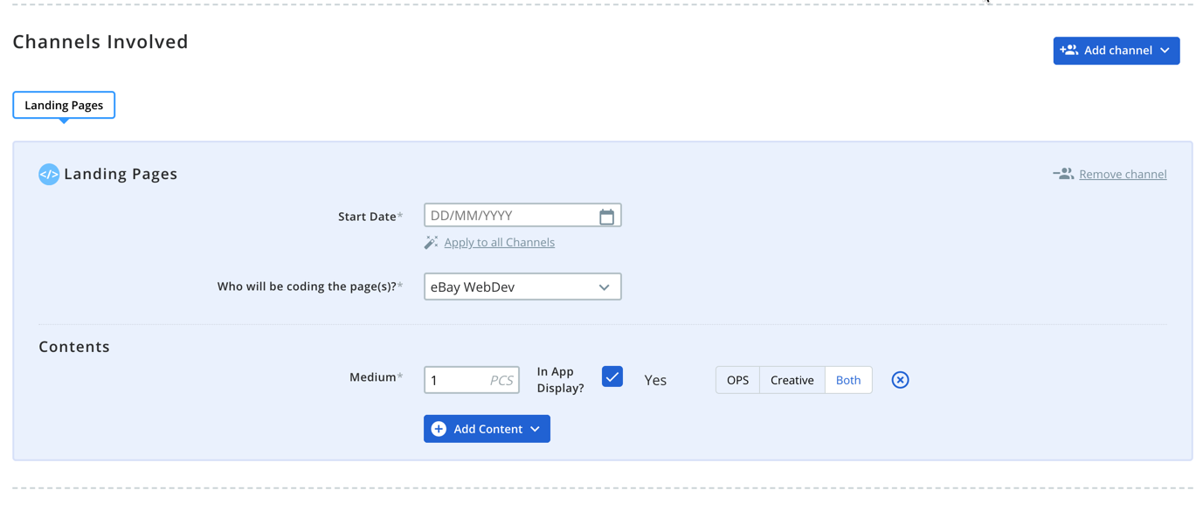
Addition of new content design along with ops, creative, or both selection
Notes:
Landing Pages
- Addition of new content design along with ops, creative, or both selection

Slide 12
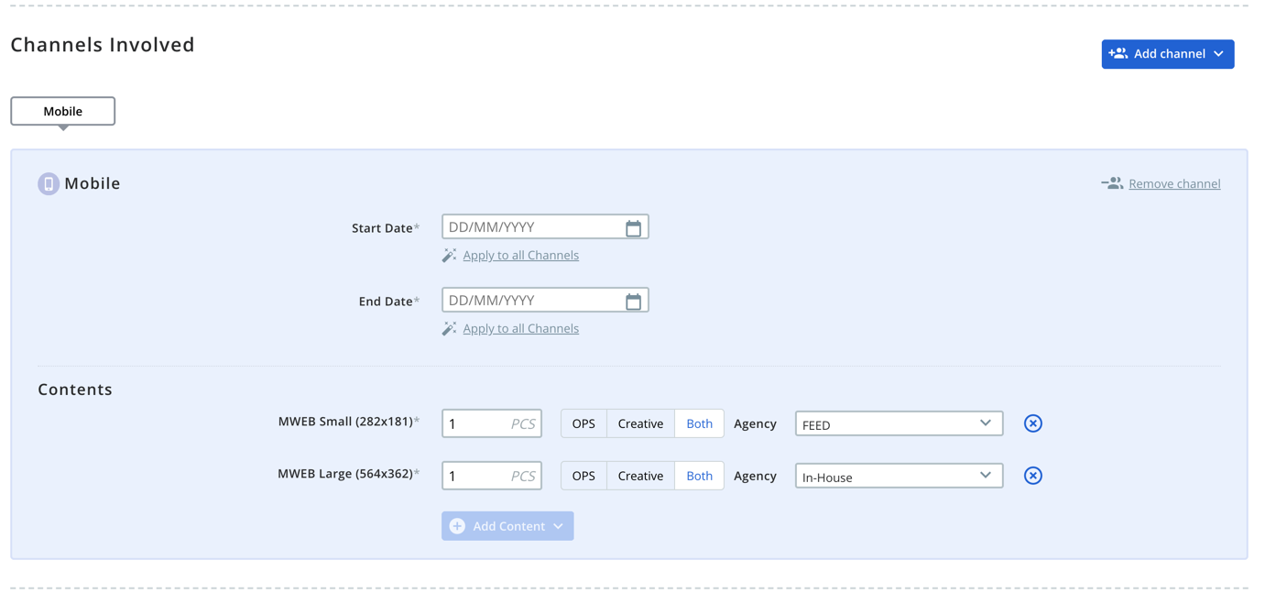
Change in selectable assets being either MWEB Small or MWEB Large meant for both Android & iOS always.
New: Content structure
Notes:
Mobile
Change in selectable assets being either MWEB Small or MWEB Large meant for both Android & iOS always.
New Content structure

Slide 13
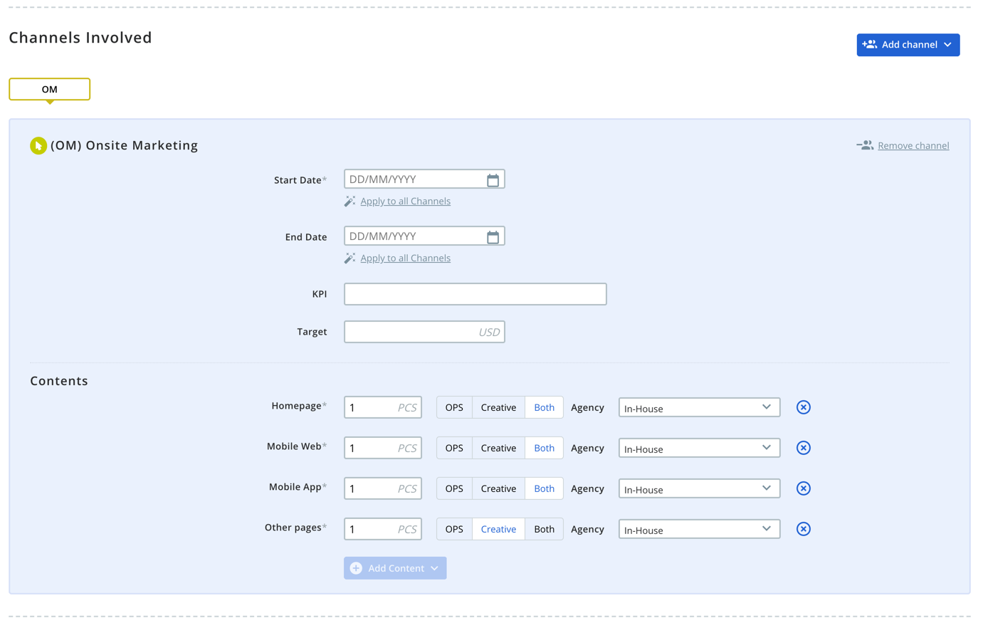
New asset menu including: Homepage, Mobile Web, Mobile App, and Other Pages
Old creative only assets being migrated to Other pages Creative Only
New Content structure
Notes:
OM
New asset menu including: Homepage, Mobile Web, Mobile App, and Other Pages
Old creative only assets being migrated to Other pages Creative Only
New Content structure

Slide 14
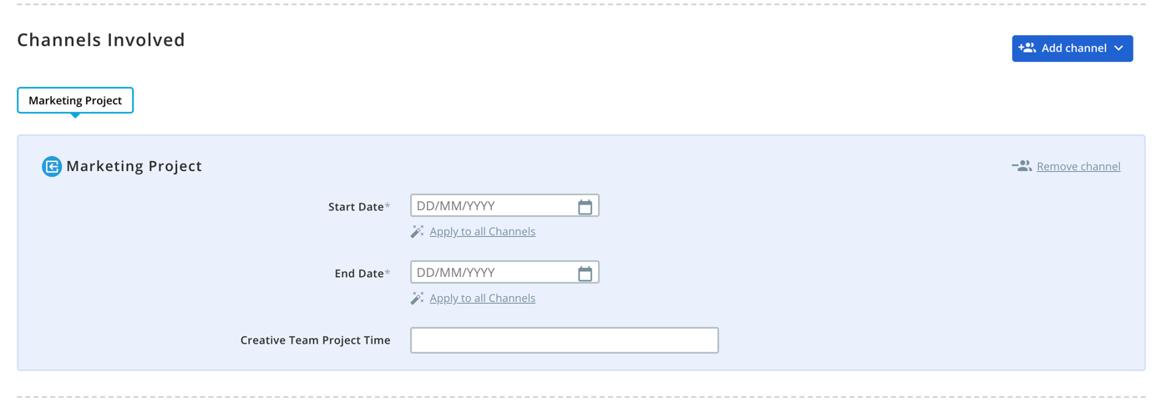
Channel Replacing the RM Project channel.
Meant to track Marketing team project time for campaigns / Projects that take#e more time than a classic campaign.
Time in Minutes entered into the Creative Team Project Time field.
Notes:
Marketing Project
- Channel Replacing the RM Project channel.
Meant to track Marketing team project time for campaigns / Projects that také more time than a classic campaign.
Time in Minutes entered into the Creative Team Project Time field.

Slide 15
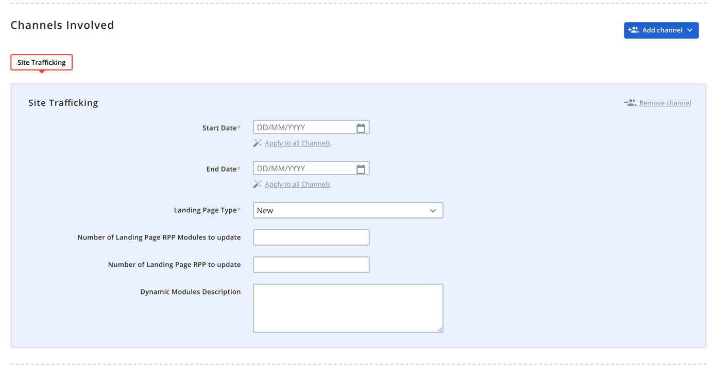
For US only
Remains the same as previous iteration
Notes:
Site Trafficking:
US ONLY
Remains the same as previous iteration

Slide 16
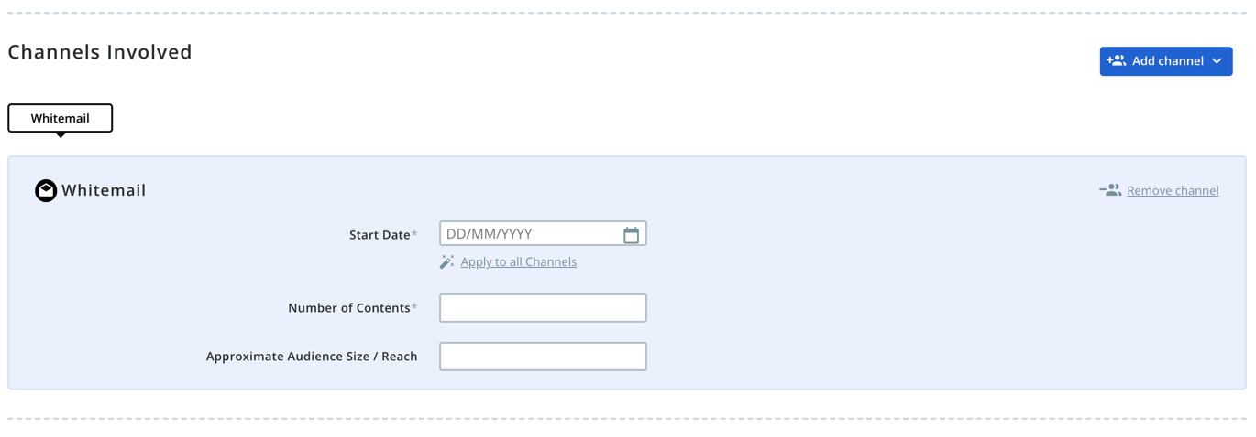
New Channel
Notes:
Whitemail
- New Channel

Slide 17
New channel with contents moved from the OM channel to the Event Channel.
Browse Nodes added to the content menu
Notes:
Event
New channel with contents moved from the OM channel to the Event Channel.
Browse Nodes added to the content menu

Slide 18
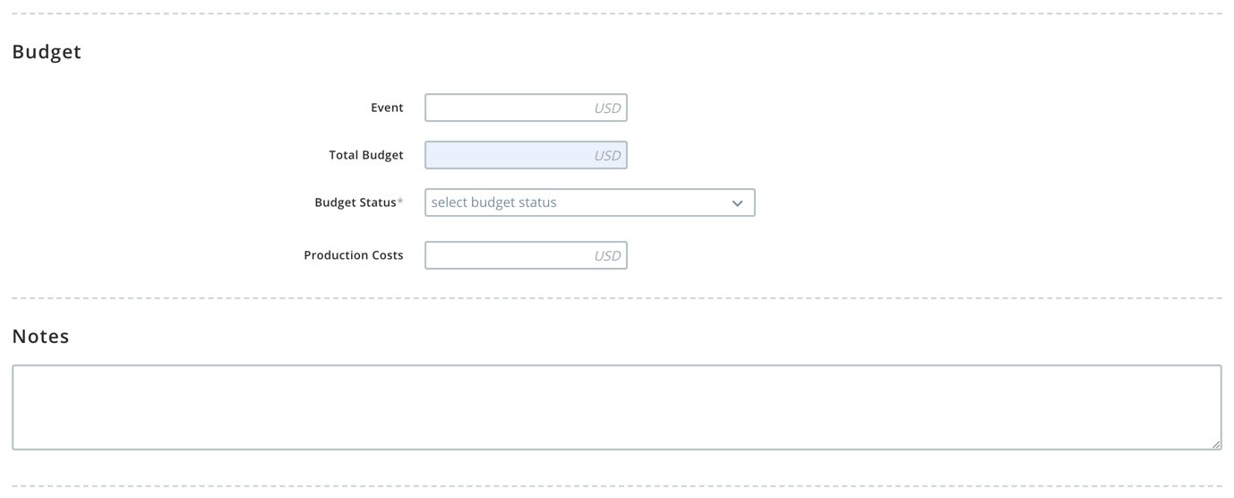
Budget section: only needed for paid channels
Fields added dynamically according to the paid channels selected.
Notes:
Budget Section:
Only needed for paid channels
Fields added dynamically according to the paid channels selected.

Slide 19
View Campaign

Slide 20
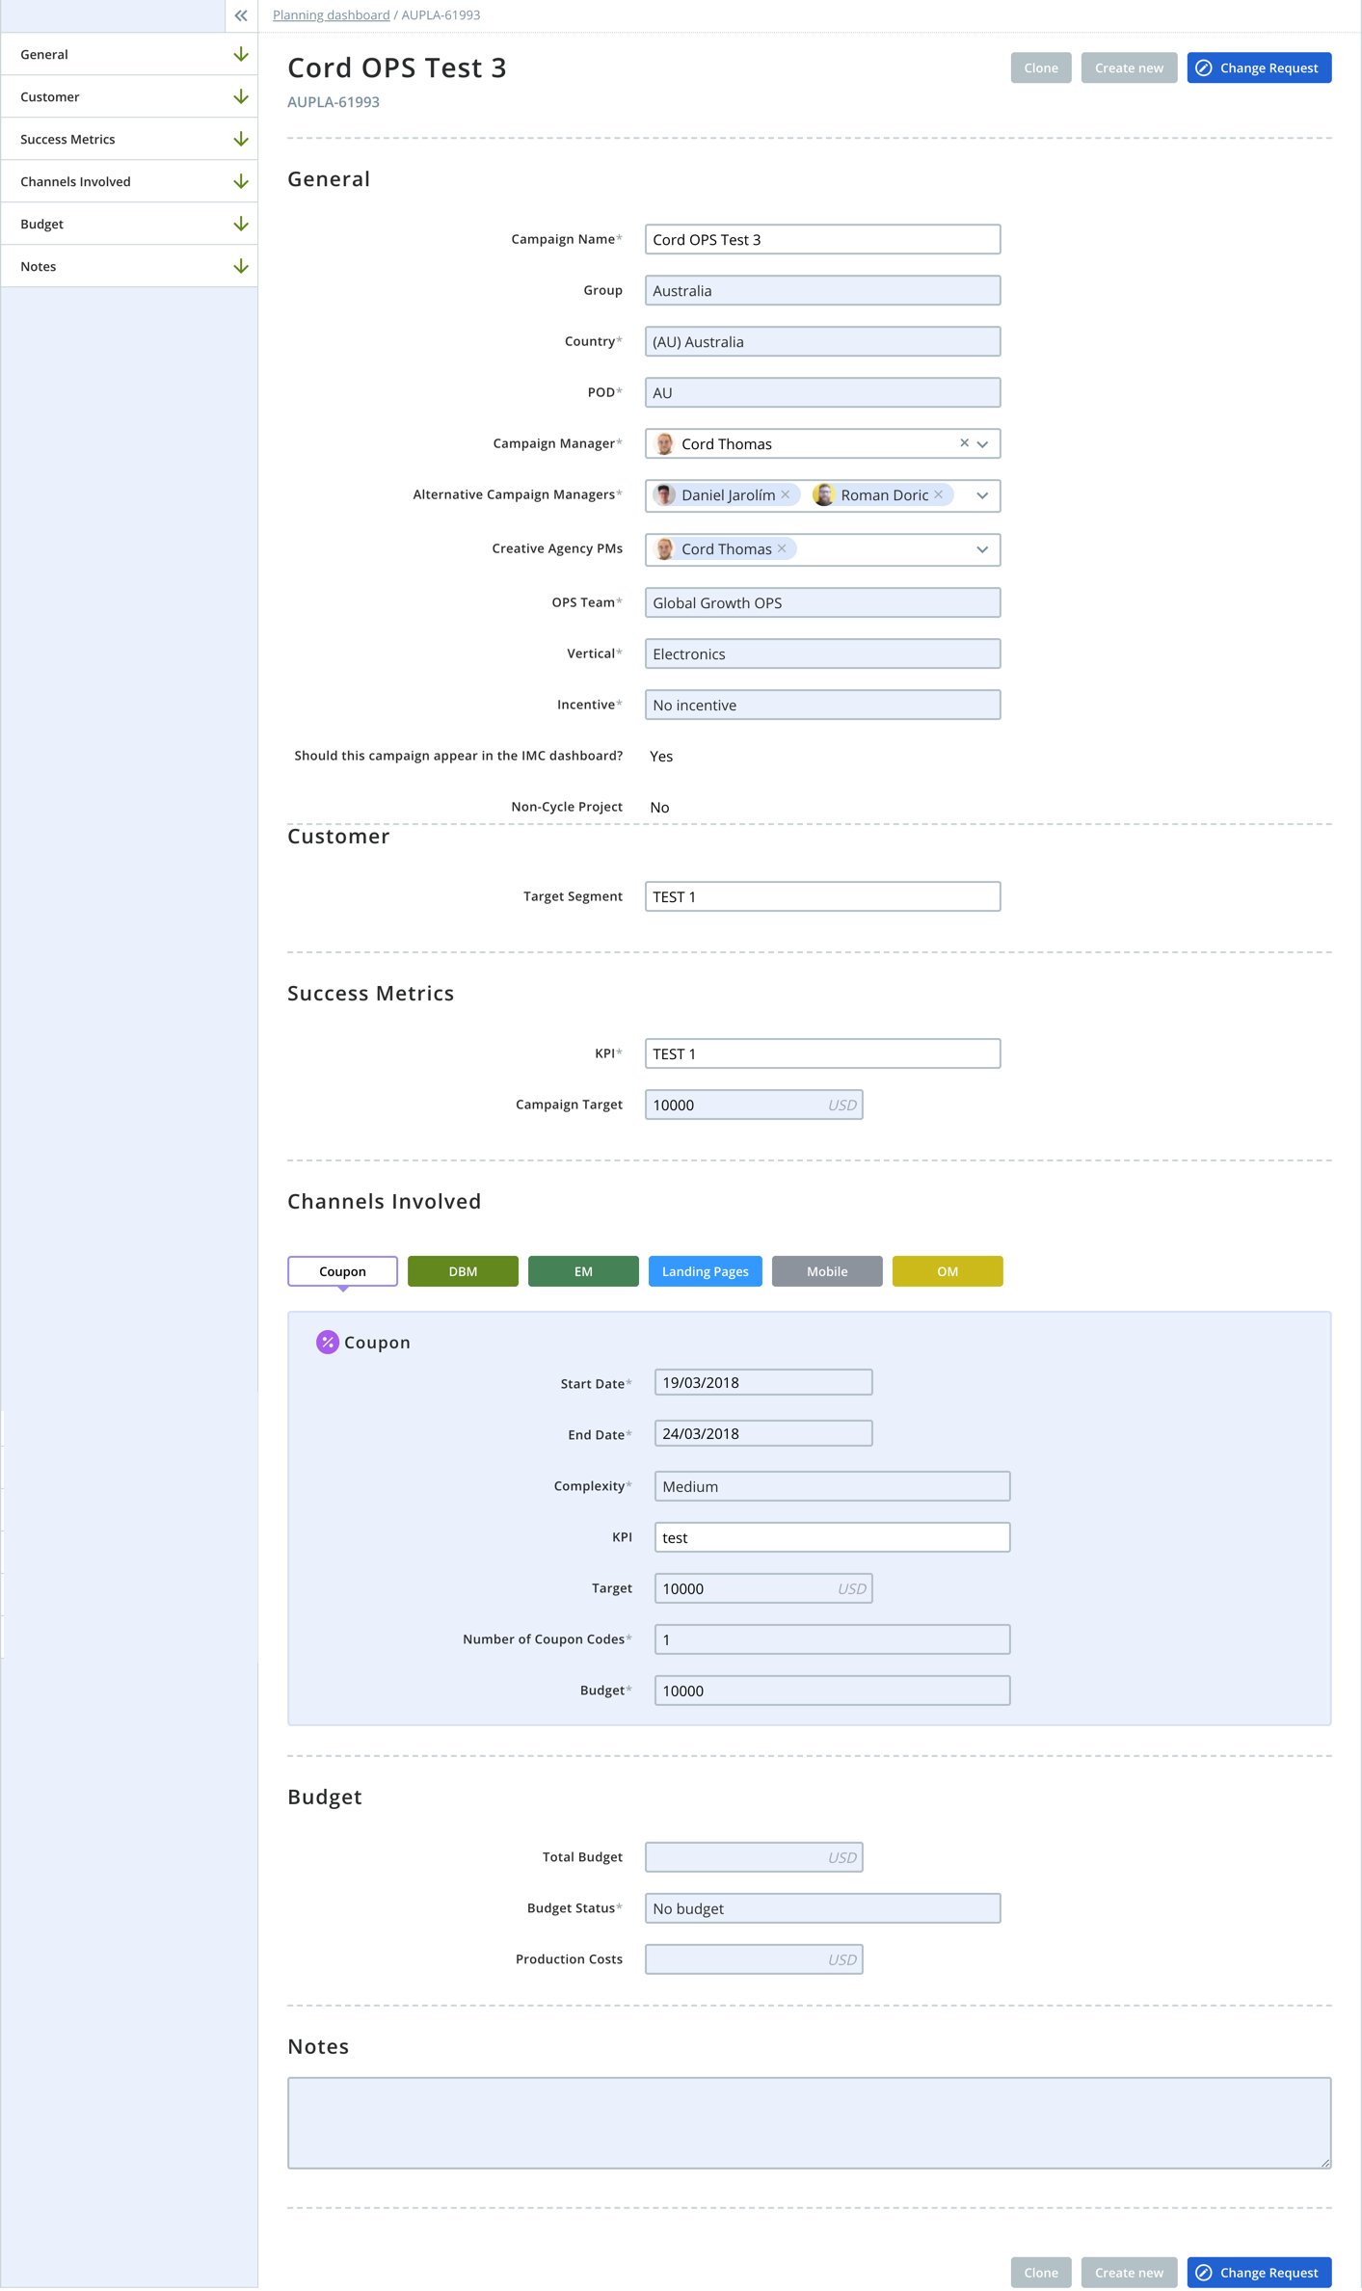
New: View Campaign
View only version of the campaign request form.
All paths from Creative, OPS, Planning dashboard lead to the view screen.
Notes:
New View Campaign Form
View only version of the campaign request form.
All paths from Creative, OPS, Planning dashboard lead to the view screen.

Slide 21
Planning Dashboard

Slide 22
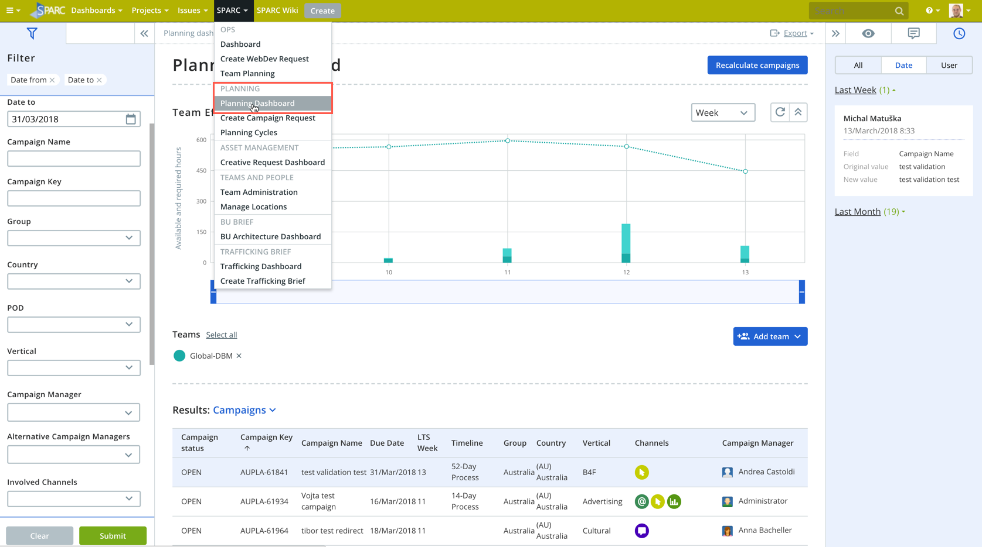
Navigation to Planning Dashboard: from the SPARC dropdown menu or the SPARC homepage
Notes:
Navigation to Planning Dashboard
- From the SPARC dropdown menu or the SPARC homepage

Slide 23
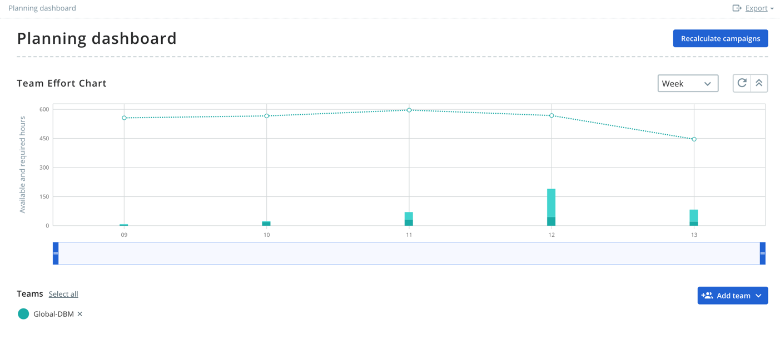
Planning Chart: new
Adding teams below chart
New recalculate campaigns option to refresh the chart
Drag slider to zoom in on the chart
Faster loading
Notes:
Planning Chart
- New view
Adding teams below chart
New recalculate campaigns option to refresh the chart
Drag slider to zoom in on the chart
Fast loading

Slide 24
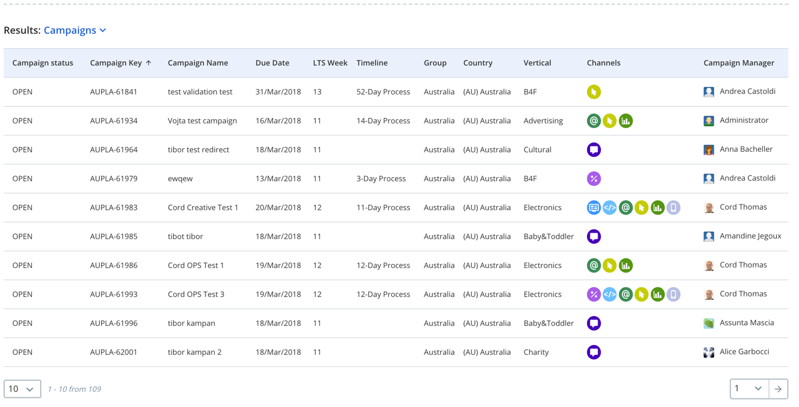
New: Campaign Results
New option to look at campaigns as a whole for campaign managers
After clicking on a campaign, in the detail view, a CM can find the view form, or click on the actions button to find options for going to: ops request, creative request, viewing the timeline, making a change request, or cloning the campaign.
Notes:
New Campaign Results View
New option to look at campaigns as a whole for campaign managers
After clicking on a campaign, in the detail view, a CM can find the view form, or click on the actions button to find options for going to the ops request, creative request, viewing the timeline, making a change request, or cloning the campaign.

Slide 25
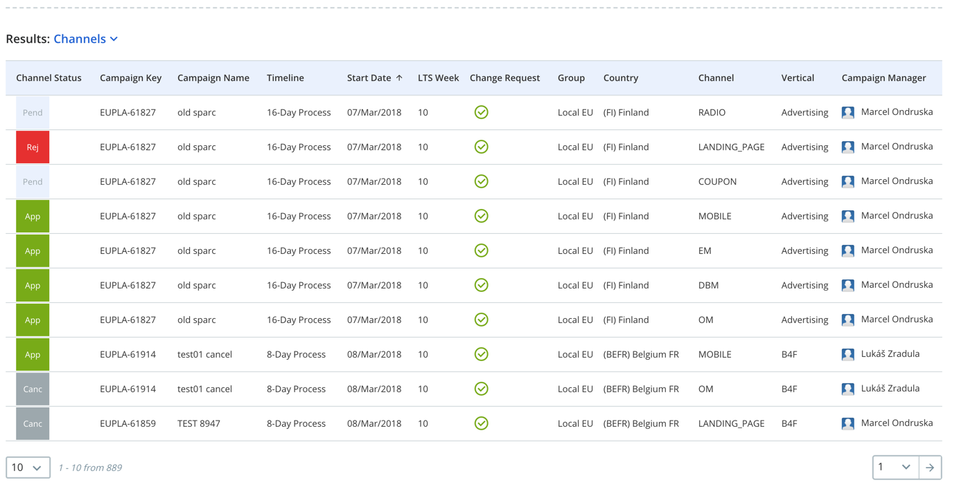
Channel view: Same as previous iteration
Notes:
Channel view
- Same as previous iteration

Slide 26
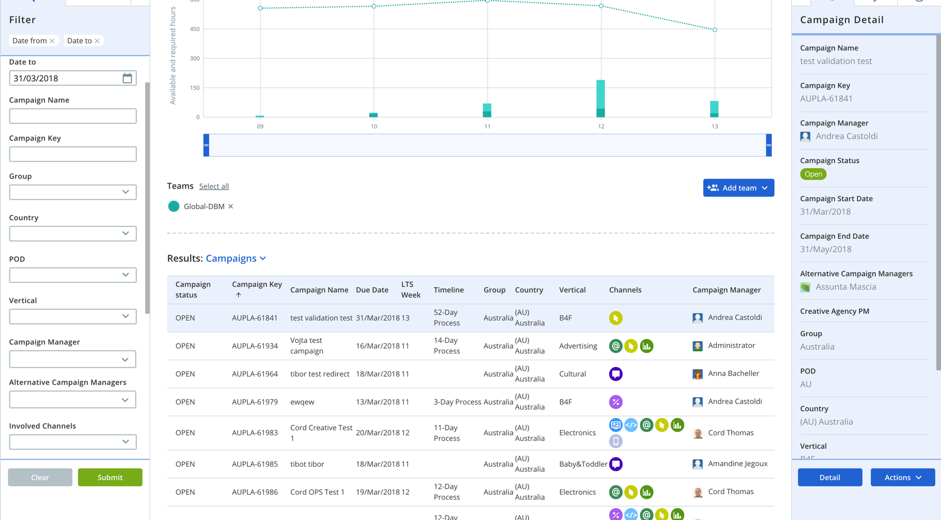
Filter & Campaign Detail: information stays the same as the previous iteration
Detail view split into 3 tabs: detail, comments, history
Filtering data can be removed at the top of the filter
Notes:
Filter & Campaign Detail
Filter information stays the same as the previous iteration
Filtering data can be removed at the top of the filter
Detail view broken up into 3 tabs, detail, comments, and history.

Slide 27
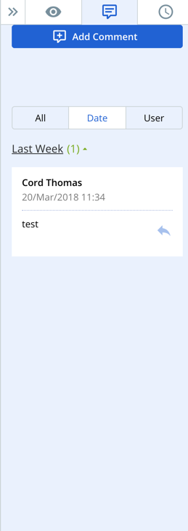
New Campaign Comments
use Add Comment button
Multiple comments can be added to a campaign
Notes:
New Campaign Comments
Added with the add comment button
Multiple comments can be added to a campaign.

Slide 28
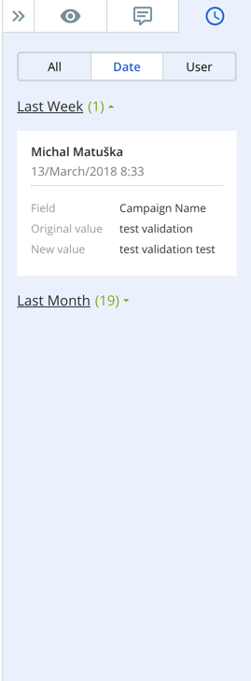
History
New: can be filtered by date or user
Catches all of the history of changes within the campaign.
Notes:
History
Can be filtered by date or user newly
Catches all of the history of changes within the campaign.

Slide 29
You’re all set! Make sure you watch the training video as well.

