Slide 1
Test presentation
Made by Politschuk

Slide 2
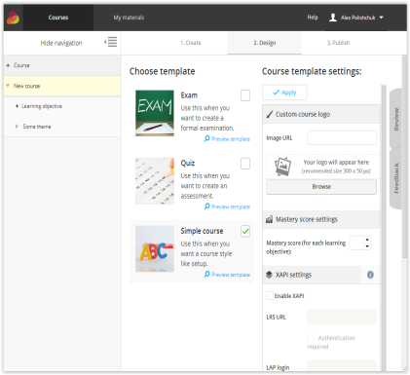
Test slide #1
Lists:
One;
Two;
Three.
Different :
1
11
2
22
3
33
4
44.
Questions | Account
Content; Single choice; Multiple choice; | Free plan
Some text:
Some text:

Slide 3
Test slide #2
Links:
Text | staging
Hello World! | 1
Links in list:
Google WWWWWWWWWWWWWWWWWWWWWWWWWWWWWWWWWWWWWWWWWWWWWWWWWWWWWWWWWWWWWWWWWW
Vkontakte путінський
Facebook американський

