Slide 1
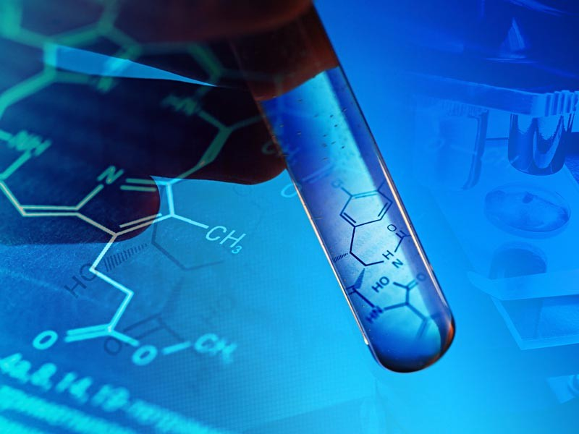
Module 2 Organic Chemistry
Section 2: Unsaturated Hydrocarbons
Notes:
1

Slide 2
Key Concepts
Define alkenes
Describe bonding in alkenes
Constitutional isomers
Naming alkenes
Cis-trans isomerization
Addition reactions of alkenes
Carbocations and alternate reaction pathways
Combustion of alkenes
Recognizing and naming alkynes
Aromatics

Slide 3
Alkenes
Hydrocarbons containing a carbon-carbon double bond
(unsaturated)
CH₂=CH₂

Slide 4
Alkenes
Alkenes are formed by loss of hydrogen atoms from adjacent carbon atoms
loses a hydrogen
- 2H
CH₃-CH₂-CH₂-CH₃
CH₂=CH-CH₂-CH₃

Slide 5
Table of Alkenes (C_{n}H_{2n})
n | Molecular formula | Expanded Molecular Formula | Name
2 | C₂H₄ | CH₂=CH₂ | ethene
3 | C₃H₆ | CH₂=CHCH₃ | propene
4 | C₄H₈ | CH₂=CHCH₂CH₃ | 1-butene
5 | C₅H₁₀ | *CH₂=CHCH₂CH₂CH₃ | 1-pentene
6 | C₆H₁₂ | CH₂=CHCH₂CH₂CH₂CH₃ | 1-hexene
7 | C₇H₁₄ | CH₂=CHCH₂CH₂CH₂CH₂CH₃ | 1-heptene
8 | C₈H₁₆ | CH₂=CHCH₂CH₂CH₂CH₂CH₂CH₃ | 1-octene
9 | C₉H₁₈ | CH₂=CHCH₂CH₂CH₂CH₂CH₂CH₂CH₃ | 1-nonene
10 | C₁₀H₂₀ | CH₂=CH(CH₂)₇CH₃ | 1-decene
*Alternative formula: CH₂=CH(CH₂)₂CH₃

Slide 6
Constitutional Isomers
Must consider:
1) Different carbon skeletons are possible
2) Different placement of the functional group (the double bond)

Slide 7
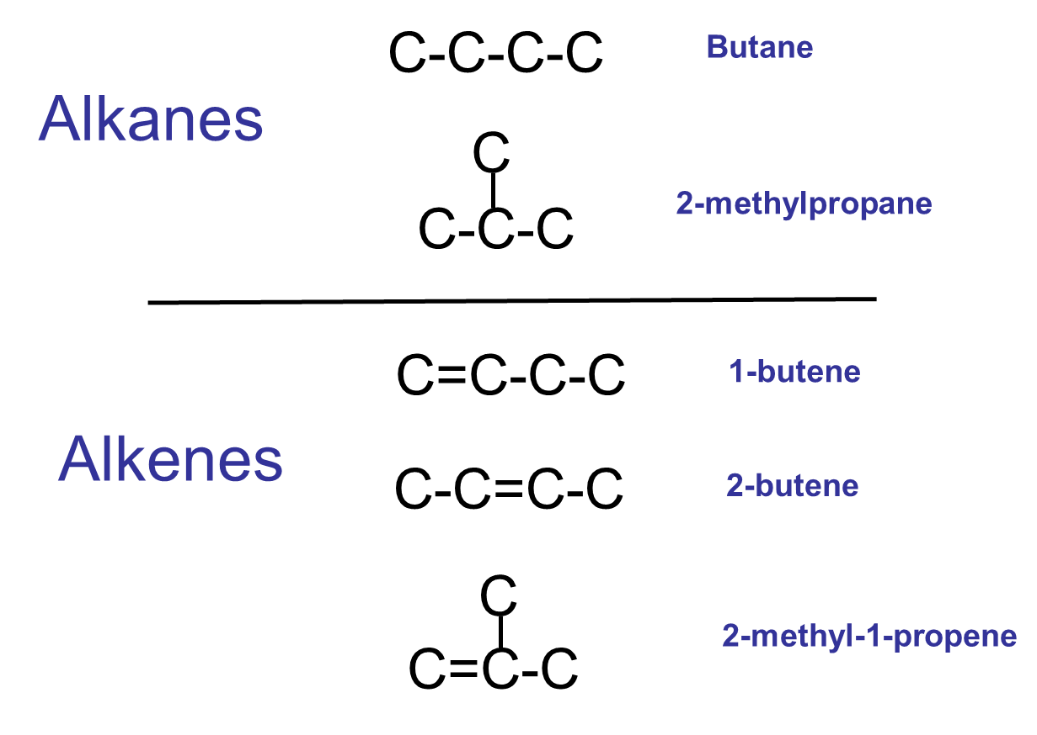
Structural Isomers of C₄H₁₀ and C₄H₈

Slide 8
Rules for Naming Alkenes
Name the longest chain that includes the double bond (parent chain)
Start numbering from end closest to the double bond
Change parent name ending from –ane to –ene. Number(s) preceding parent name identify location of double bond(s).
Names of substituents are preceded by numbers indicating their position on the longest chain.

Slide 9
Rules for Naming Alkenes
5. A compound with two double bonds is a diene and is given the ending –adiene. Two numbers identify the double bonds.
6. Cyclic compounds with a double bond are cycloalkenes. Start numbering at one of the double bonded carbons and continue giving the smallest numbers to any substituent groups.

Slide 10
Test Your Skills
Draw and name all constitutional isomers of the alkene
C₅H₁₀

Slide 11
Trigonal Bond Angles of Carbons in the Alkene Double Bond
Planar geometry
No rotation around double bond

Slide 12
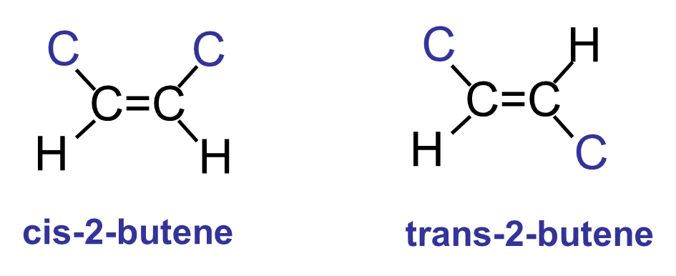
Cis and Trans Isomers
C=C in double bonds cannot rotate freely like C-C in single bonds. This gives rise to geometric isomers (cis-trans).
Cis–trans isomerism is possible whenever an alkene has two different substituent groups on each carbon that forms the double bond.

Slide 13
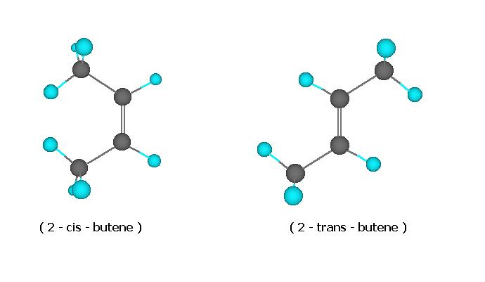
Ball-and-stick models of 2-butene
cis-2-butene
trans-2-butene

Slide 14
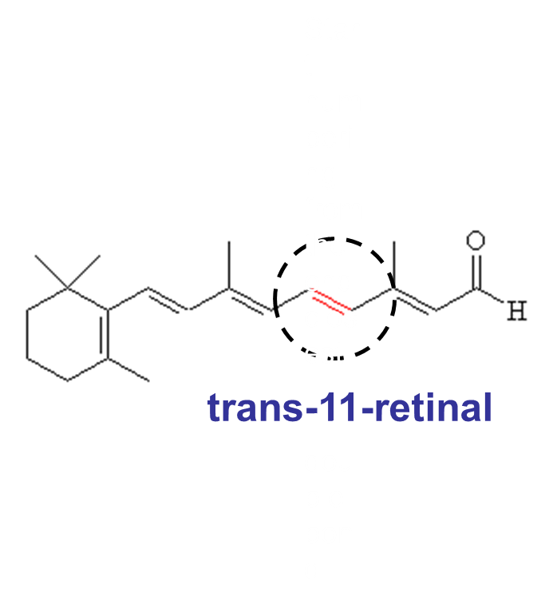
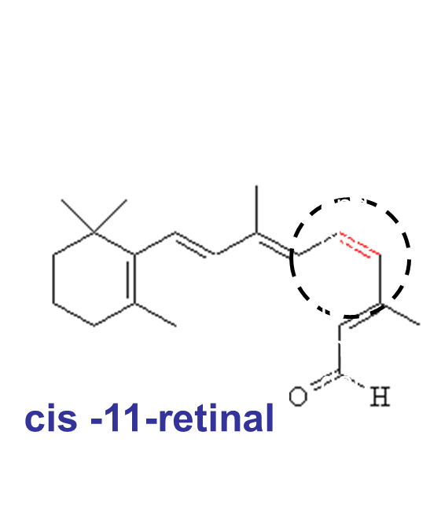
Cis-trans isomerism of 11-retinal is responsible for vision.
hv
Comes out of the receptor and
sends signal to the brain. Enzyme
converts it back
Fits well in the receptor

Slide 15
Addition Reactions of Alkenes
Hydrogen (H₂) (Hydrogenation) - symmetric reagent, requires Pt or Ni as a catalyst
Halogen (F₂, Cl₂, Br₂) (Halogenation) - symmetric reagent
Hydrogen Halide (HCl, HBr, HI) -(Hydrohalogenation) - asymmetric reagent
Water (Hydration) - asymmetric reagent

Slide 16
1-Hexene gives a positive test with Br₂. The deep red color of Br₂ is decolorized as it reacts with the double bond of 1-hexene.
Addition of Br₂ to an Alkene

Slide 17
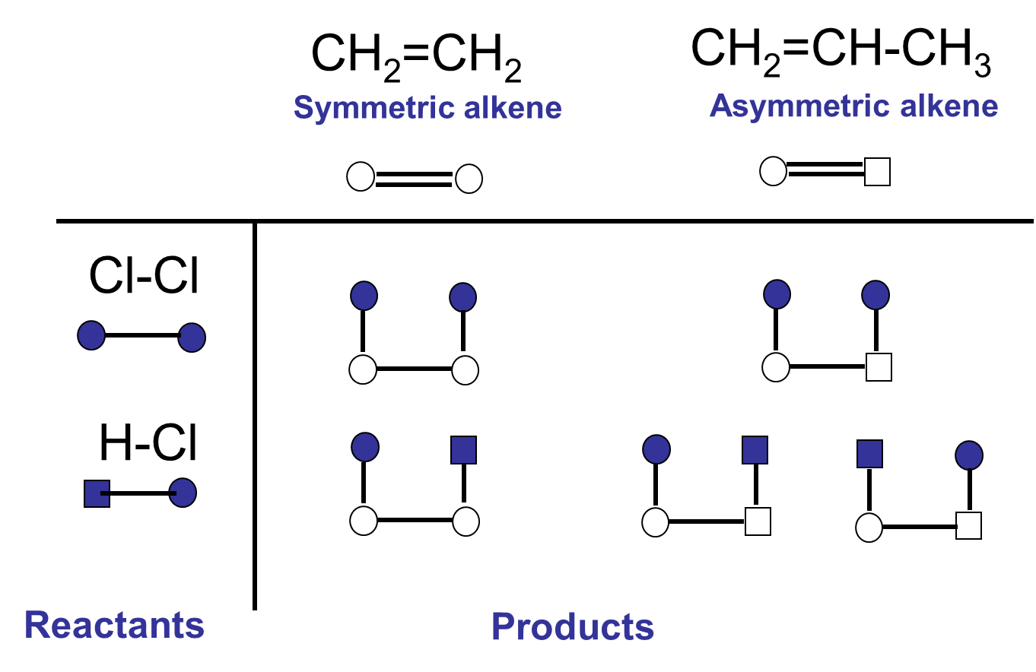
Possible Addition Reactions of Alkenes

Slide 18
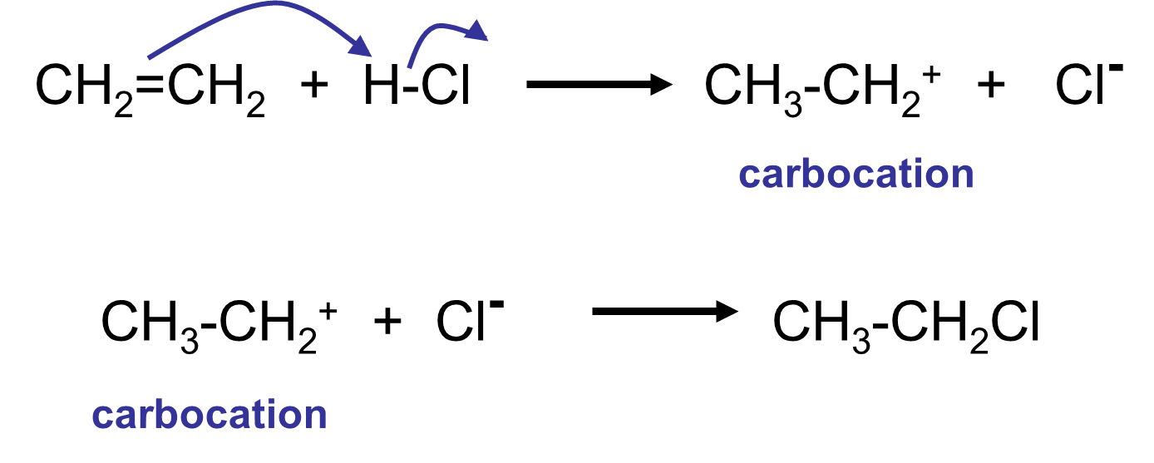
Formation of a Carbocation

Slide 19
Markovnikov’s rule
In an addition reaction of an asymmetric reagent with an asymmetric alkene, the major product is the one formed when hydrogen from the asymmetric reagent (HX) adds to the double-bonded carbon that initially has the most hydrogens.

Slide 20
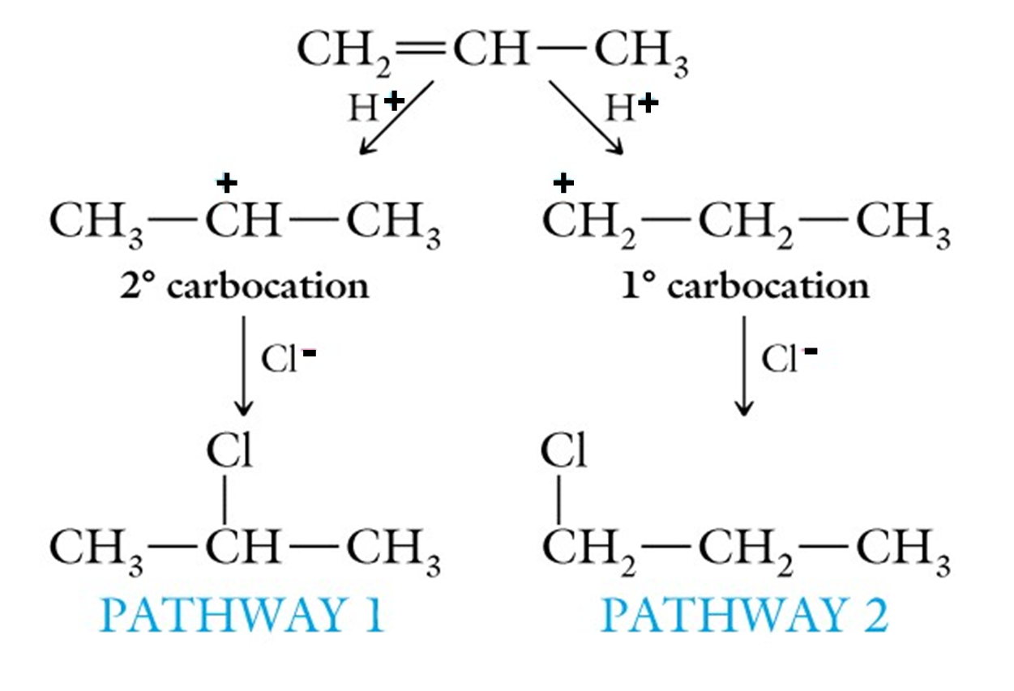
Markovnikov’s rule
Major product Minor product

Slide 21
Stability of Carbocations
R = another C atom or group of C atoms

Slide 22
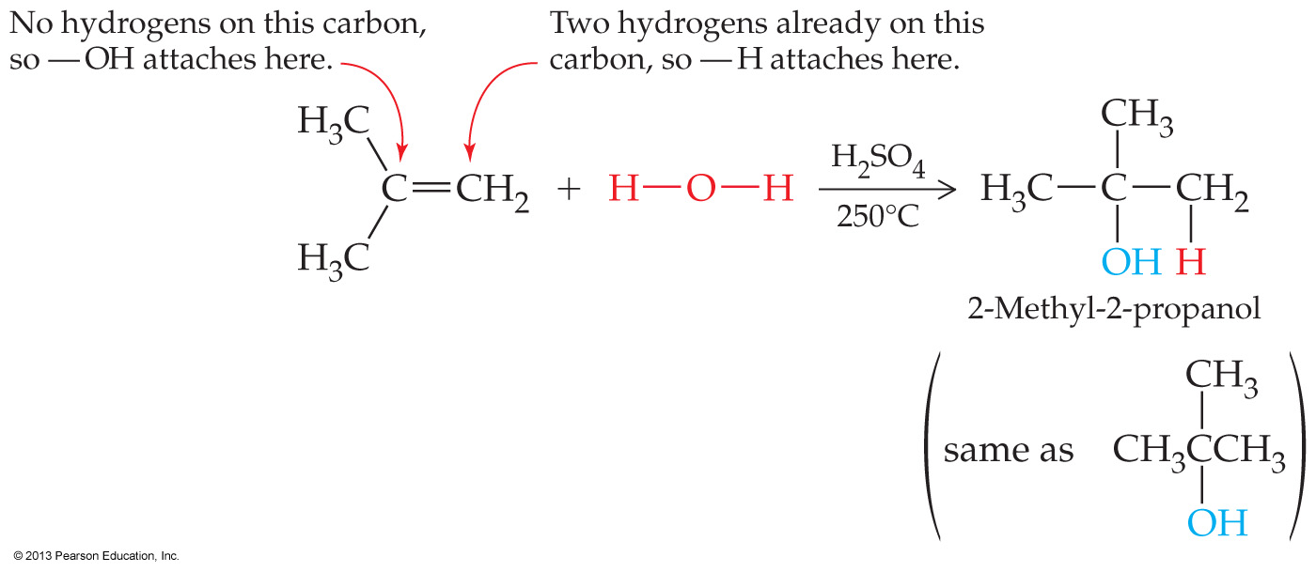
Hydration of Alkenes
Water is an asymmetric reagent and can add to double bonds in the presence of a strong acid to form an alcohol

Slide 23
Combustion of Alkenes
Like other hydrocarbons alkenes burn in the presence of oxygen producing carbon dioxide and water

Slide 24
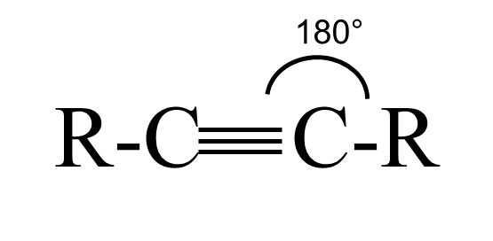
Alkynes
Carbon–carbon triple bonds

Slide 25
Naming Alkynes
Name just like alkenes except change the ending to –yne instead of –ene
Cis-trans isomerism is not possible for alkynes (180º bond angles)

Slide 26
Aromatic Compounds
Organic compounds that have a cyclic conjugated double bond system are considered aromatic hydrocarbons.
H
H
H
or
or
H
H
H
benzene is an example of an aromatic hydrocarbon

Slide 27
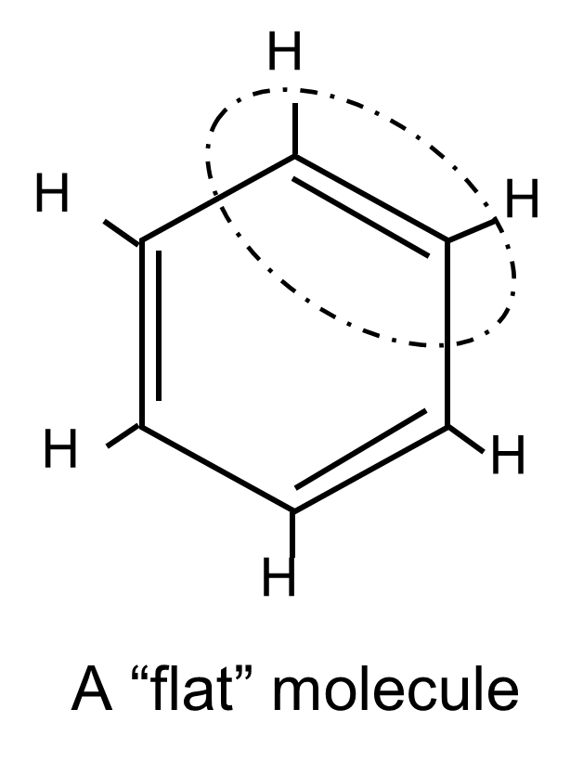
Double Bonds in Benzene Have Trigonal Planar Structure

Slide 28
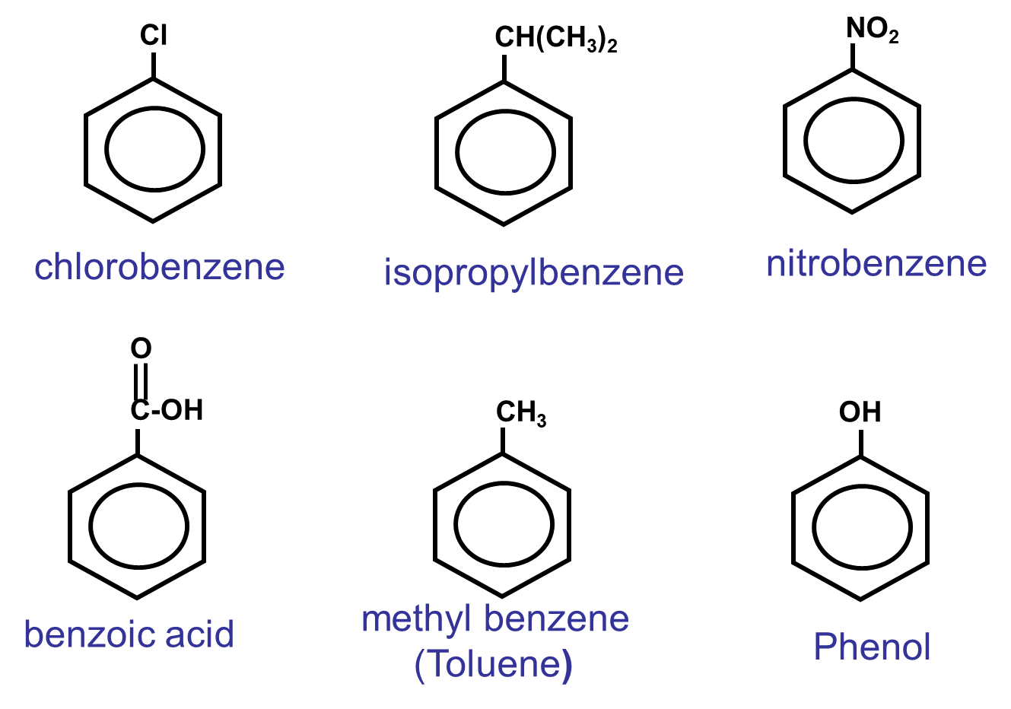
Names of Some Aromatics

