Slide 1
Module 2
Organic Chemistry
Section 4: Aldehydes and Ketones

Slide 2
Key Concepts
The carbonyl group
Identify aldehydes and ketones
Naming aldehydes and ketones
Constitutional isomers
Physical properties of aldehydes and ketones
Oxidation and reduction reactions of aldehydes and ketones
Formation of aldehydes and ketones from alcohols

Slide 3
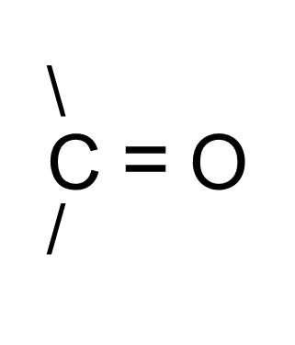
Structure of Aldehydes and Ketones
Aldehydes and ketones contain a carbonyl group.

Slide 4
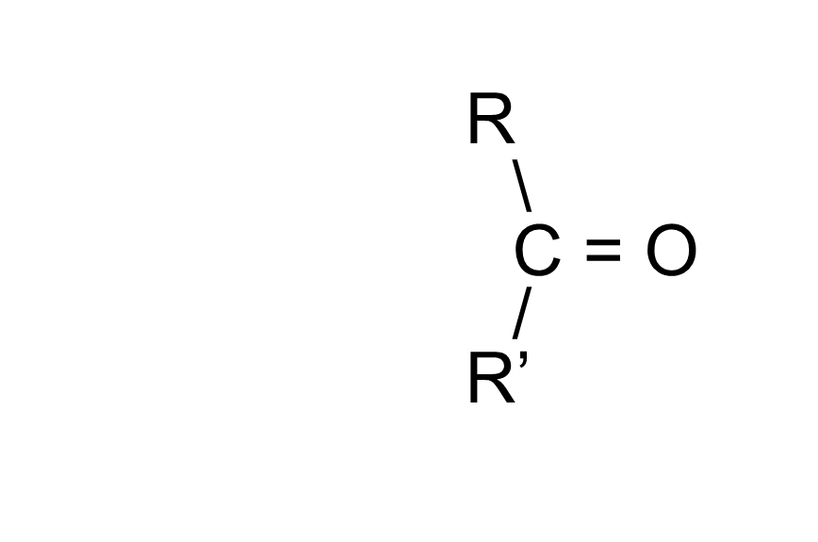
The Carbonyl Group
The group is trigonal planar – flat

Slide 5
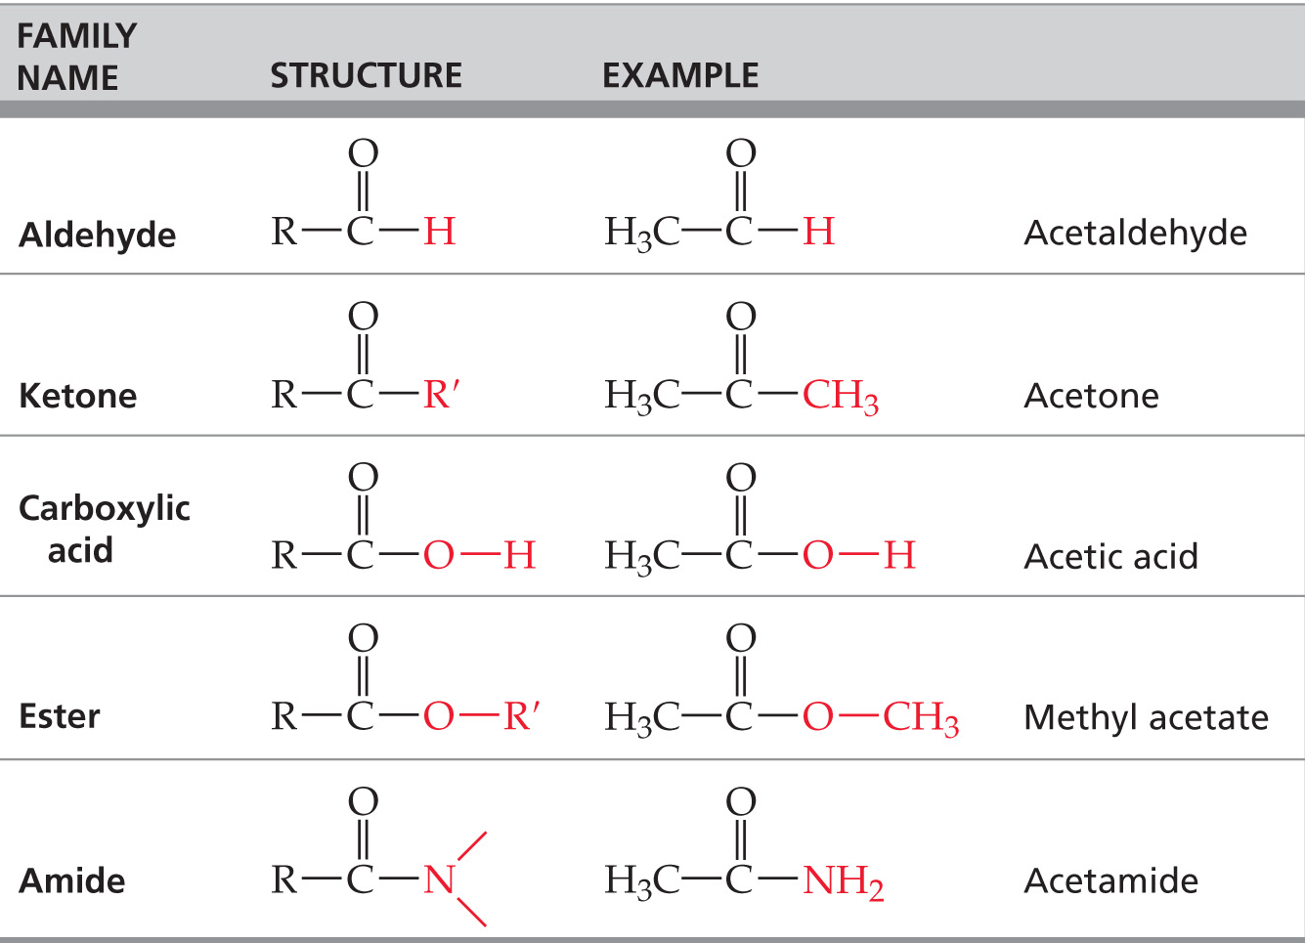
Organic Families Containing the Carbonyl Group

Slide 6
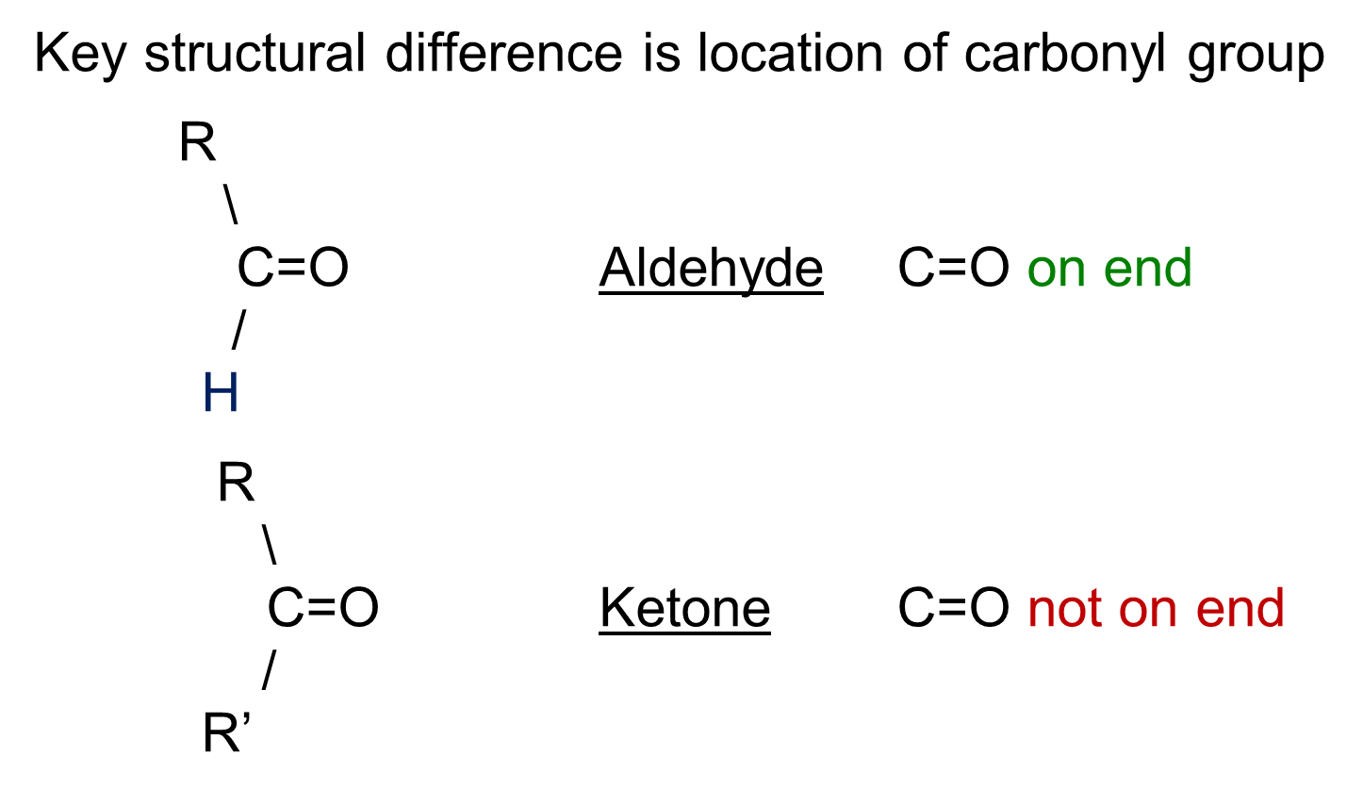
Aldehydes and ketones

Slide 7
Aldehyde Nomenclature
Find longest carbon chain that contains the aldehyde group.
Change ending of base alkane name from -e to -al.
All other branches and groups are named using standard IUPAC system.

Slide 8
Examples
CH₃CH₂CH₂CHO
CH₃CH₂CHBrCH₂CHO
CH₃CH₂C(CH₃)₂CH₂CHO
CH₃C(CH₃)ICH₂CHO
butanal
3-bromopentanal
3,3-dimethylpentanal
3-iodo-3-methylbutanal

Slide 9
Examples
C = C - C - CHO
3-butenal
H CH₃
\ /
C = C H
/ \ /
H₃C CH₂ - C
\\
O
cis-
3-methyl-3-pentenal

Slide 10
Ketone Nomenclature
Find longest chain that contains C=O.
Must not be at end or it is an aldehyde.
Change ending of base alkane name from -e to -one.
Find lowest number to show location of the carbonyl C=O.
Name and number substituents as before.

Slide 11
Examples
CH₃C(=O)CH₃
CH₃CH₂CH(CH₃)C(=O)CH₃
CH₂BrCH₂C(=O)CH₂CH₃
CH₃CCl₂C(CH₂CH₃)₂C(=O)CH₂CH₃
2-propanone
3-methyl-2-pentanone
1-bromo-3-pentanone
4,4-diethyl-5,5-dichloro-3-hexanone

Slide 12
Examples
O
||
C - C - C - C - C
|
C - C - C - Cl
|
Cl
7,7-dichloro-4-methyl-3-heptanone
CH₃
/
2-methylcyclopentanone
O

Slide 13
Constitutional Isomers of Aldehydes and Ketones
How many aldehyde and ketone isomers are possible for
C₄H₈O
C
O
C-C-C-C=O
C-C-C=O
C-C-C-C
butanal
2-methylpropanal
2-butanone

Slide 14
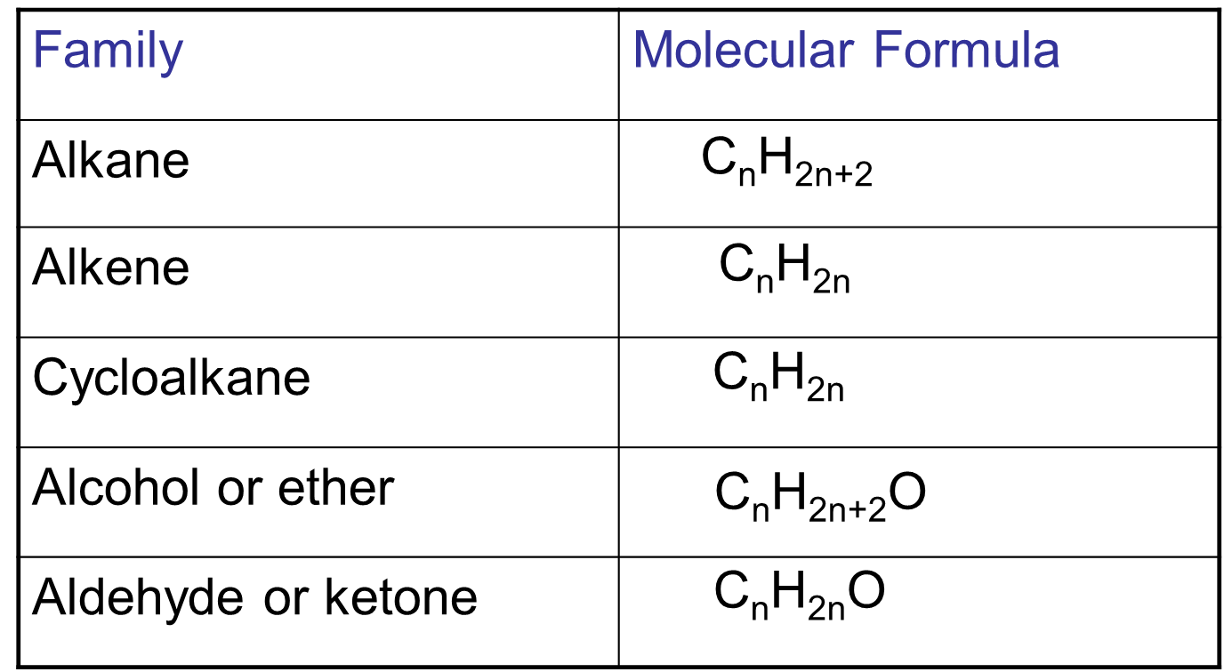
Molecular Formula of Different Families

Slide 15
Physical Properties of Aldehydes and Ketones
Higher boiling points than corresponding alkanes but lower than similar alcohols.
Alcohols can hydrogen bond with each other but aldehydes and ketones cannot.
Higher boiling points relative to alkanes are primarily due to dipole-dipole attractions.

Slide 16
Interactions Between Carbonyl Groups
δ⁻
O
C
δ⁺
H
H
δ⁻
O
Dipole-dipole
attraction
C
δ⁺
H
H
δ⁻
O
C
H
δ⁺
H

Slide 17
Physical Properties of Aldehydes and Ketones
Shorter chain aldehydes and ketones (<5-6 carbons) are soluble in water due to ability to accept hydrogen bonds from water.
Longer chain molecules are poorly soluble in water.

Slide 18
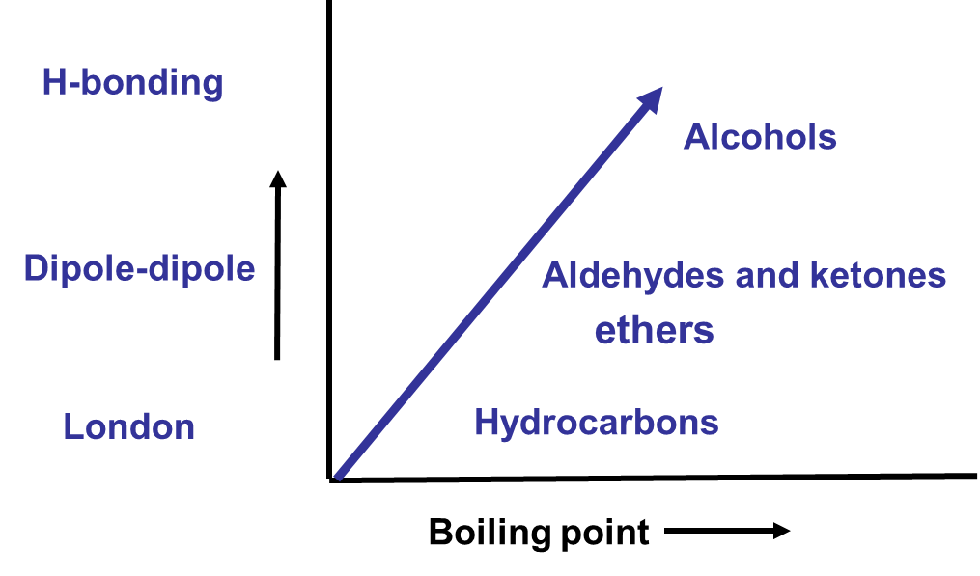
Boiling Point and Intermolecular Forces

Slide 19
Oxidation of Aldehydes and Ketones
Aldehydes are oxidized to carboxylic acids
(H on C=O is replaced by –OH)
Ketones are not oxidized (contain no H on C=O)

Slide 20
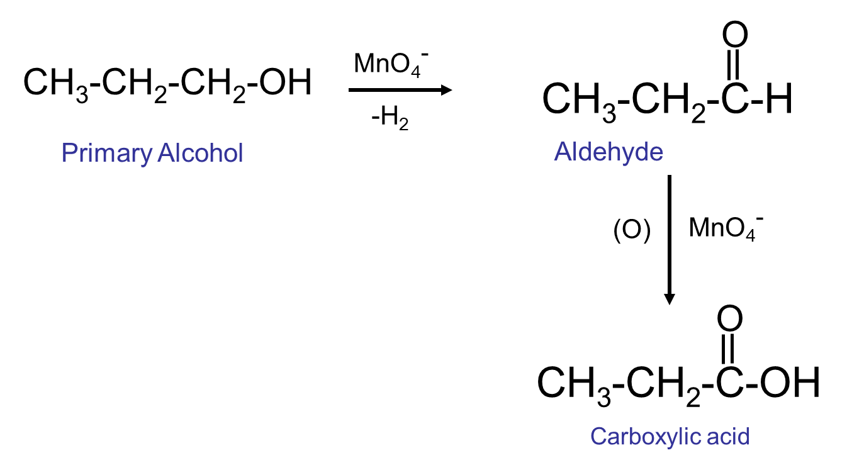
Oxidation of Primary Alcohols to form Aldehydes and Carboxylic Acids

Slide 21
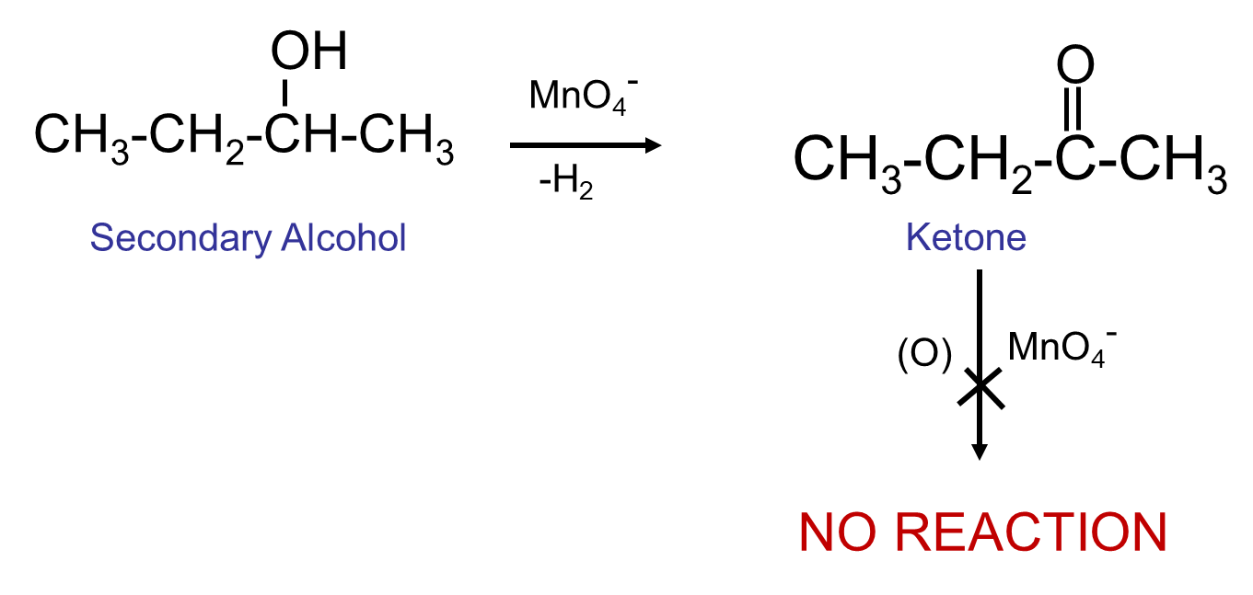
Oxidation of Secondary Alcohols to Form Ketones

Slide 22
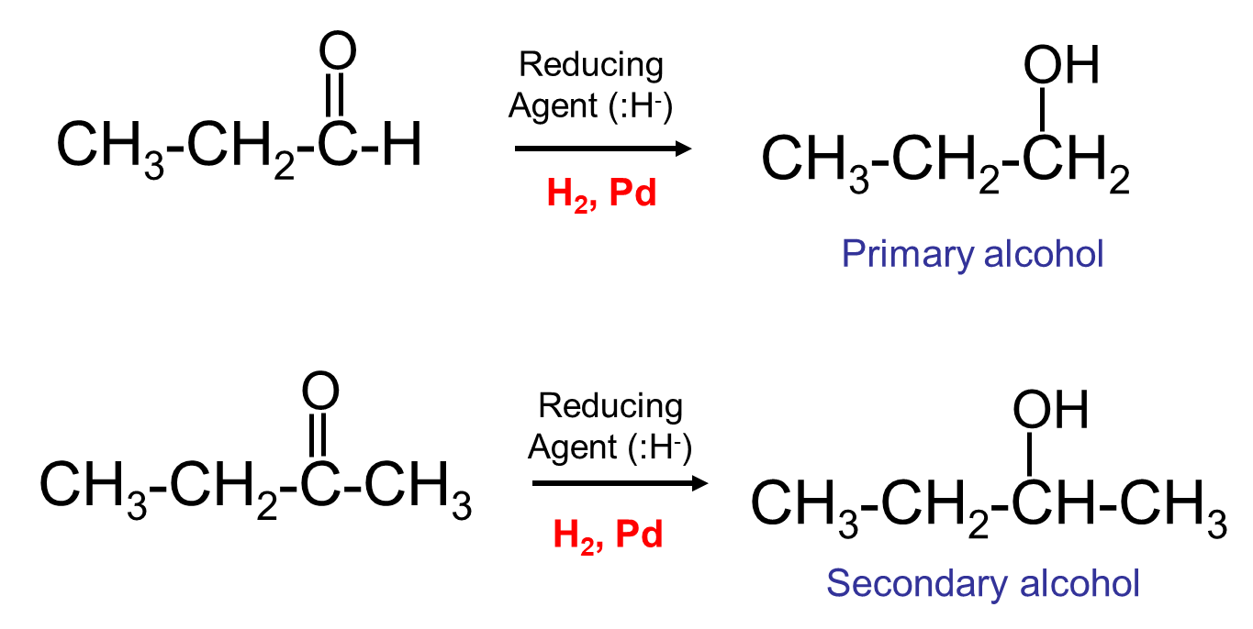
Reduction of Aldehydes and Ketones
Both can be reduced to Alcohols

