Slide 1
Handgun Licensing for Instructors:
Renewal Certification
2017

Slide 2
Summary of Objectives
New Legislation (SB16, HB3784, and SB263)
State Seal of Texas
Required Reporting to DPS
Opt In List (updating)
Contact Handgun Licensing

Slide 3
Summary Of New LTC Legislation
Effective September 1, 2017, new legislation impacting LTC:
New Fees/Reduction Of Application Fees SB 16 and HB 3784
Online Course Providers HB 3784
Removal of caliber proficiency requirement SB 263

Slide 4

FEE Changes For License To Carry
Effective September 1, 2017: New FEE changes will go into effect. These changes have been implemented in accordance with new legislation. (S.B. No. 16/HB 3784)
Fee Schedule can be found on the DPS website

Slide 5
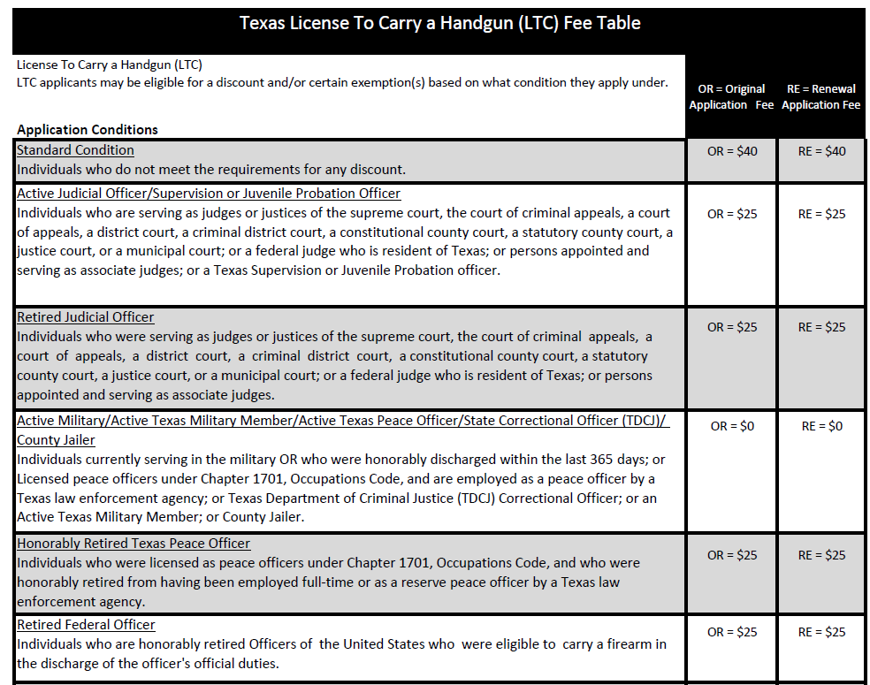
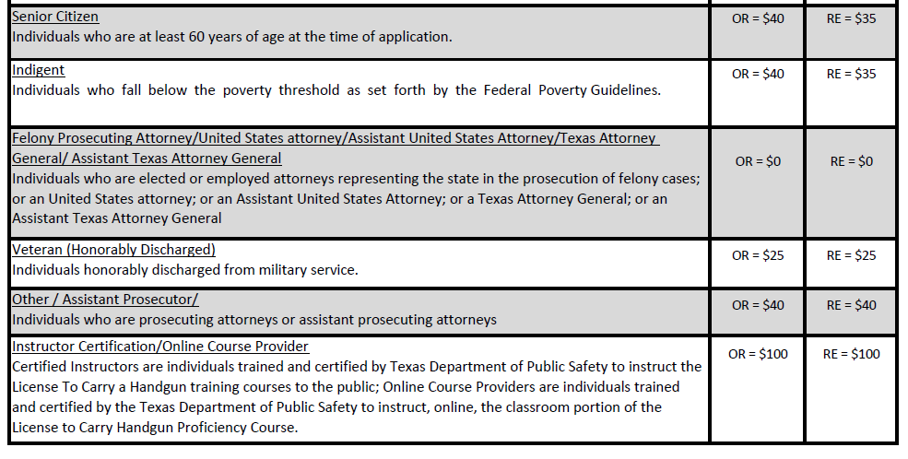
FEE Changes For License To Carry

Slide 6

LTC Online Course Providers
The Department is in the process of establishing rules, forms and curriculum for Online Course Providers to administer the classroom portion of the handgun proficiency course and written exam (Per GC 411.171).
1. At least three (3) years experience providing online course instruction.
2. Experience working with governmental entities.
3. Direct knowledge of handgun training.
Note: The Approved Online Course Provider application fee is: $100.00

Slide 7

LTC Online Course Providers
Requirements for LTC Online Course Providers Classroom(Per GC 411.190).
The online course must be at least four (4) and no more than six (6) hours.
Must be administered via a secure web portal.
Must provide the Student with an LTC-101 Form
Submit an LTC-9 Class Completion form to the department
Note: All online training records must be maintained and available for a period of six (6) years.

Slide 8

LTC Online Course Providers
Applicants who complete the online course must still complete the range instruction part of the handgun proficiency course.
Applicant who complete the online course must be given an additional one (1) to two (2) hours of range training before completing the range proficiency demonstration.
  For example: laws relate to weapons, handgun use and safety, proper storage of handgun with emphasis on storage, etc.…

Slide 9
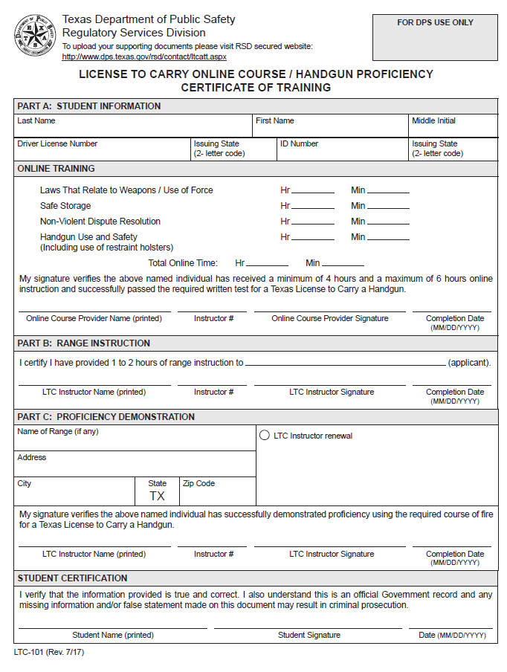
Certificate of Online Training (LTC-101)
Part A. Student Information Section:
Make sure the Last, First and M.I. (if applicable) is complete and legible.
Next ensure the DL or ID number and state fields are complete.
Online Training Section:
Must complete the classroom hours of instructions (Min.4 hrs.- Max. 6 hrs.).
Next complete Instructor’s printed name, Instructor number, Instructor signature and completion date.

Slide 10
Certificate of Online Training (LTC-101)
Part B. Range Instruction Training Section (LTC Instructor):
Applicant successfully completed 1-2 range instruction training
Complete Instructor’s printed name, Instructor number, Instructor signature and completion date.
Part C. Proficiency Demonstration:
Must complete the name of range, address, city, state and zip.
Gun Range must be in the State of Texas.
Gun Range address must have a complete physical address (No P.O. Box will be excepted)
Complete Instructor’s printed name, Instructor number, Instructor signature and completion date.
Student Certification:
Student must complete the following fields- student printed name, student signature and date.
Students are responsible for submitting the LTC-101 not the instructor.
Note: A copy of the LTC-101 should be maintained by the Instructor and an LTC-8 submitted.

Slide 11
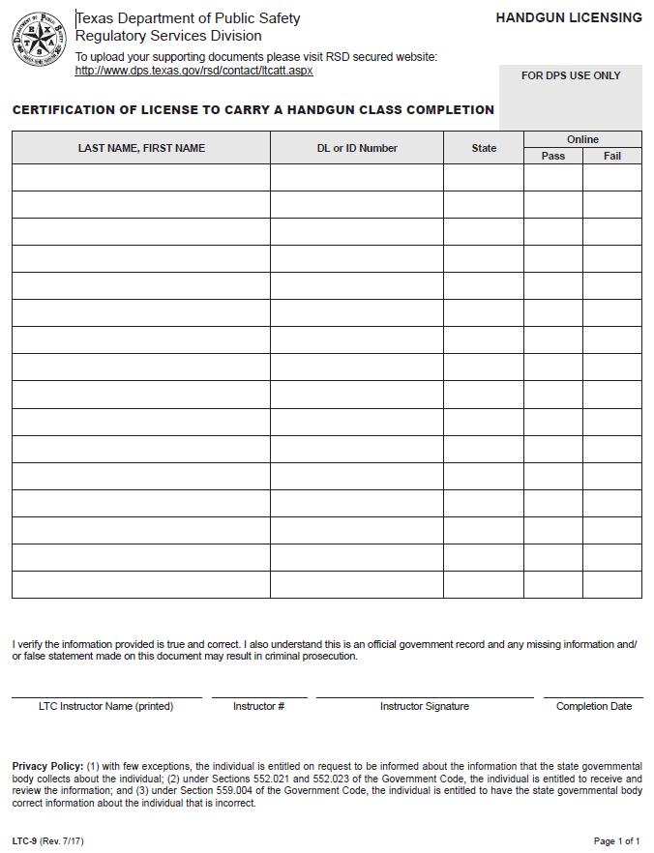
Online Class Completion (LTC-9)
Student Information Sections:
Make sure the Last and First names are complete and legible.
Next ensure the DL or ID number and state fields are complete.
Online Section:
Mark Pass or Fail
Instructor Certification:
Make sure the Online Course Provider name is complete and legible.
Make sure the Instructor # is complete and legible.
Make sure the Instructor Signature is complete and legible. (Electronic signatures are accepted)
Make sure the Completion Date is complete and legible.
Upload document:
https://www.dps.texas.gov/rsd/contact/ltc-8.aspx

Slide 12
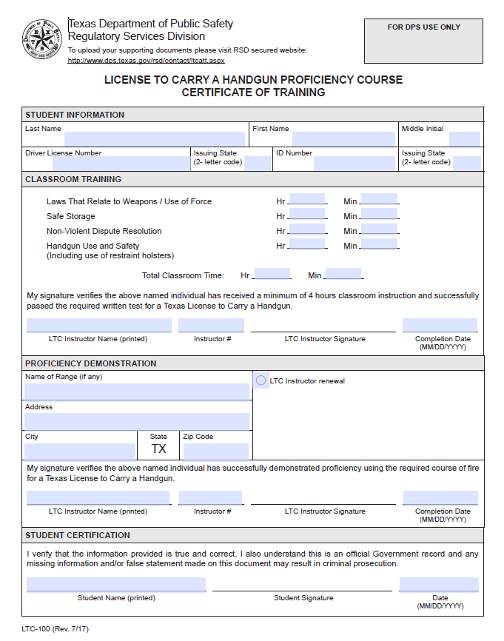
Certificate of Training (LTC-100)
Student Information Section:
Make sure the Last, First and M.I. (if applicable) is complete and legible.
Next ensure the DL or ID number and state fields are complete.
Classroom Training Section:
Must complete the classroom hours of instructions (Min.4 hrs.- Max. 6 hrs.).
Next complete Instructor’s printed name, Instructor number, Instructor signature and completion date.
Proficiency Demonstration:
Must complete the name of range, address, city, state and zip.
Gun Range must be in the State of Texas.
Gun Range address must have a complete physical address (No P.O. Box will be excepted)
LTC Instructor renewal – please check this box only upon renewal of an instructor when demonstrating proficiency.
Next complete Instructor’s printed name, Instructor number, Instructor signature and completion date.
Student Certification:
Student must complete the following fields- student printed name, student signature and date.
Students are responsible for submitting the LTC-100 not the instructor.

Slide 13
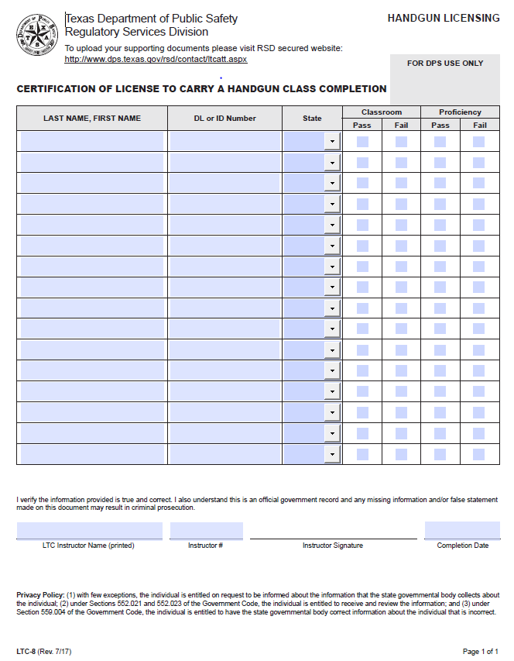
Class Completion (LTC-8)
Student Information Sections:
Make sure the Last and First names are complete and legible.
Next ensure the DL or ID number and state fields are complete.
Classroom/Proficiency Section:
Mark Pass or Fail as needed (leave blank if one part was not completed)
Instructor Certification:
Make sure the Online Course Provider name is complete and legible.
Make sure the Instructor # is complete and legible.
Make sure the Instructor Signature is complete and legible. (Electronic signatures are accepted)
Make sure the Completion Date is complete and legible.
Upload document:
https://www.dps.texas.gov/rsd/contact/ltc-8.aspx

Slide 14
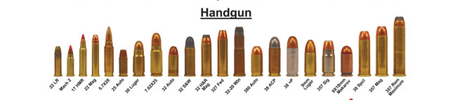
Caliber
Effective 09/01/2017: Caliber of handgun has been removed. There is no minimum caliber requirement of the handgun used to demonstrate proficiency. (S.B. No. 263) Amends Section 411.188(a)

Slide 15



STATE SEAL OF TEXAS
The State Seal of Texas cannot be used on any advertising by Instructors (Per Admin Code 6.43).
The use of an agency name, such as DPS or Department of Public Safety, and their symbols is also not allowed.

Slide 16

Class Room Instruction
Texas Admin Code rule 6.40:
No Guest Speakers
No Videos
No Webinars

Slide 17


Class Monitoring
A Certified handgun instructor shall cooperate with the department in its monitoring of the training of license applicants.
Instruction may not be conducted at any location that is not accessible to department personnel.

Slide 18
Required Reporting to DPS
Upon completion of a training course by an applicant, the Certified handgun instructor who trained the applicant shall submit a class completion report to the department indicating only whether the applicant passed or failed on Form LTC-8 or LTC-9 .
If an accidental discharge occurs during training or proficiency examination, the certified handgun instructor shall submit a report to the department within five business days. An accidental discharge report shall be submitted on Form ETR-98.
Note: Reports must be submitted within five business days on the most recent version of the forms approved by the department.

Slide 19
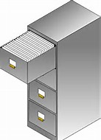

Instructor Record Keeping
A certified handgun instructor shall make available for inspection to the Department the following:
Certificate of Training (LTC-100/LTC-101): A record of each license applicant who applied for instruction, whether accepted or rejected for instruction, post-test scores – pass or fail only, proficiency demonstration – pass or fail only (target not required)
Course materials: Including curriculum, lesson plans, presentations, any documentation used during the class (including critiques or notes made by the instructor)
Copies of reports submitted to the department: LTC-8, LTC-9, LTC-95, and ETR-98
Note: Records (including old CHL forms) must be retained for a period of six (6) years after course completion. Records must be stored in a safe and secure place and must be available for inspection by the department. Electronic storage is acceptable.

Slide 20
“Opt In” Instructor Information Published by DPS
To be included on this list, Instructor’s must complete an “Opt In” form.
We are updating the list to reflect the most current information.
Please fill out the “Opt In” form to continue to be included on this list.
We are adding county information to enhance search capabilities.

Slide 21
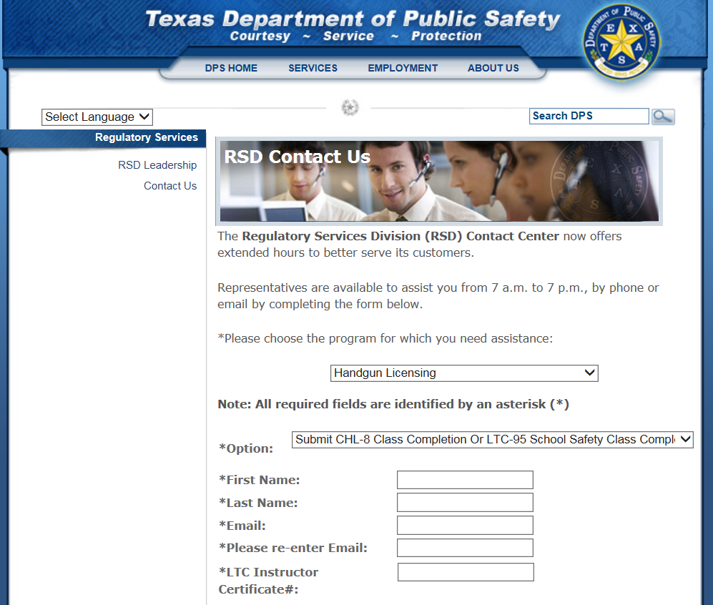
Uploading Documents
To Upload the LTC-8 or LTC- 9 documents please visit the DPS website: https://www.dps.texas.gov/rsd/contact/ltc-8.aspx
Attachments should be in PDF format only.
Can submit document using an electronic signature
If class is on 2 different days, 2 LTC-8’s need to be submitted
Please do not upload students LTC-100/LTC-101 along with the LTC-8 or LTC-9

Slide 22

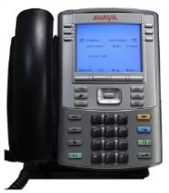


Ways to Contact Handgun Licensing
DPS Website: http://www.dps.texas.gov/rsd/ltc/index.htm
RSD Contact Center phone #: 512.424.7293
Email: https://www.dps.texas.gov/rsd/contact/ltc.aspx
Mail: Licensing and Registration Service MSC 0245
Texas Department of Public Safety
PO Box 4087
Austin, Texas 78773-0245

Slide 23

  Questions ?????

