Slide 1
A/B Testing
Pinpointing success

Slide 2
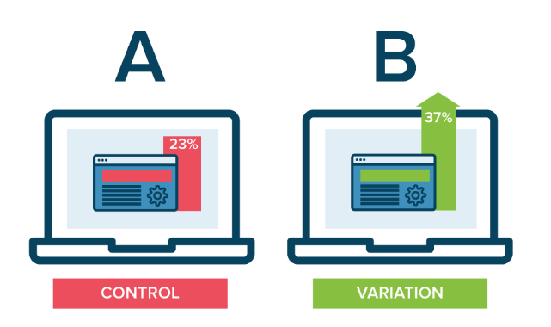
What is a/b Testing?
Comparing two versions, A and B, to see which one performs better

Slide 3
How do we measure performance?
Higher conversion rate!

Slide 4
How do we measure performance?
Potential conversions:
Visitors-> Purchasers
Queries->Executed sales
New contacts-> In person meetings
Disinterested-> Interest
Unsatisfied -> Satisfied clients

Slide 5
What can you test?
Anything that can affect behaviour!

Slide 6
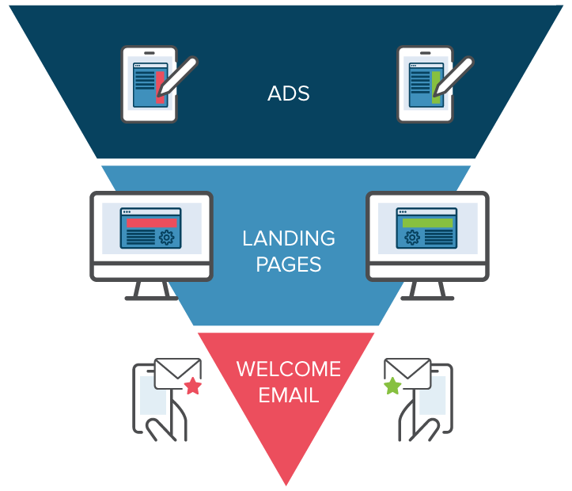
What can you test?

Slide 7
Why do we do a/b testing?
To PINPOINT success:
Which change made the impact?

Slide 8
Why do we do a/b testing?
Aim: Making the most of what you have

Slide 9
Why do we do a/b testing?
Making more out of existing traffic without paying to attract more!
We can make careful changes to user experiences to continuously improve over time.
Follow through with strategies that we KNOW are effective, and ELIMINATE those which we KNOW are not!
Return on investment can be massive:
-small changes can result in significant increases in leads generated, sales and revenue and REDUCE COSTS

Slide 10
Why do we do a/b testing?
Sony A/B tested variations of its homepage checkout page layout to increase purchases by 20%.
Secret Escapes tested variations of their mobile signup pages, doubling conversion rates and increasing lifetime value.
?

Slide 11
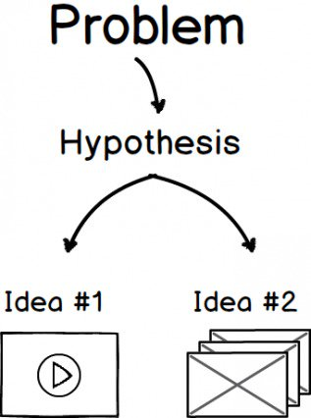
How do we a/b test?

Slide 12
How do we a/b test?
1. Start with the goal in mind

Slide 13
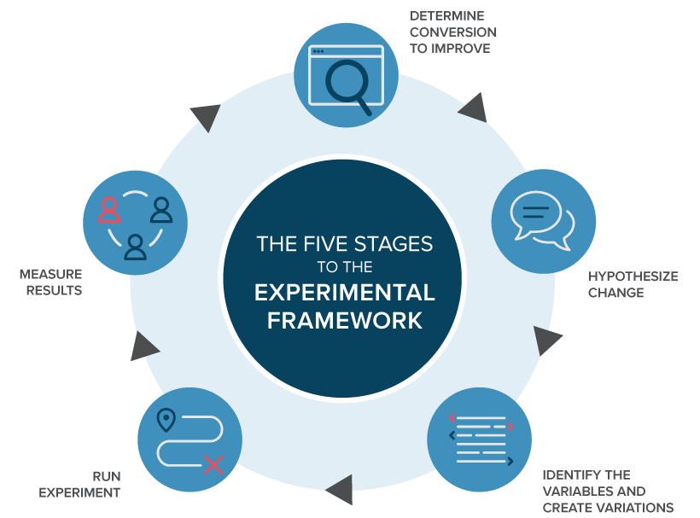
How do we a/b test?

Slide 14
How do we a/b test?
1.
Define your business objectives
Define your area goals
Define your Key Performance Indicators
Define your target metrics

Slide 15
How do we a/b test?

Slide 16
How do we A/b test?
2. Generate Hypothesis

Slide 17
How do we a/b test?
2
What can we CHANGE that may lead to the IMPACT that we WANT?
Prioritse in terms of expected impact and difficulty of implementation.
HYPOTHESIS: We expect that (change) for (population) will cause (impact(s))
Example: The first 5 words of a cold call affects the conversion rate of new potential clients TO a face-to-face meeting.

Slide 18
How do we a/b test?

Slide 19
How do we a/b test?
3. Identify variations to test

Slide 20
How do we a/b test?
- Brain storm different variations- making ONE CHANGE at a time
H:The first words of a cold call affects the conversion rate of new potential clients TO a face-to-face meeting.
Control: “Hi, my name is XXX from Seedlink Tech…”
V2: “Hi, I am calling to check if you have read my email from earlier…”
V3: “ Am I speaking to Mr.XXX from XXX corp?”

Slide 21
How do we a/b test?
Keep in mind the key performance indicators- the impact we are trying to measure.
Ie the CONVERSION RATE!

Slide 22
How do we a/b test?

Slide 23
How do we a/b test?
4. Run the CONTROLLED experiment!

Slide 24
How do we a/b test?
Ensure the minimum sample size and a representative range of potential targets have been reached
Interaction with each version is measured, counted, compared to determine how each performs.

Slide 25
How do we a/b test?

Slide 26
How do we a/b test?
5. Analyze the results

Slide 27
How do we a/b test?
Key questions:
What impact has the variation made (if any)?
Is the impact STATISTICALLY SIGNIFICANT?

Slide 28
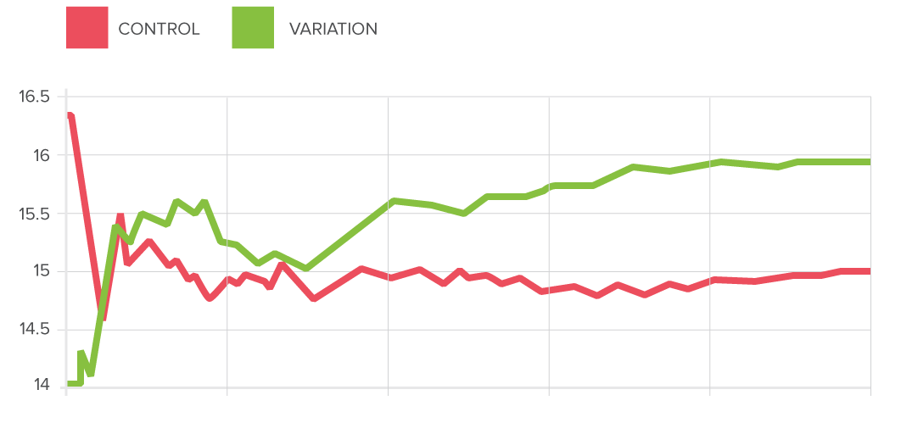
Results from a/b testing
A variation in conversion rate

Slide 29
Results from a/b testing
All findings are useful findings

Slide 30
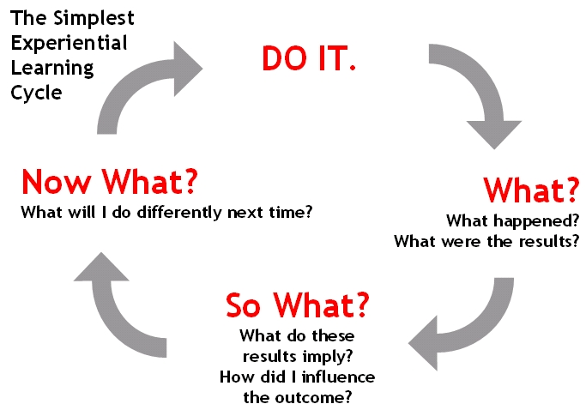
Results from a/b testing
Research
Prioritization
Experimentation
Analyze, Learn, Repeat

Slide 31
Results from a/b testing
1. If we found statistically significant results:
Variation-> Impact (positive or negative)
We can refine strategies, and use the results to make USEFUL changes
We can test further with new variations, using our findings as our control group to continuously improve
2. If we didn’t find any useful results
Variation-> NO Impact
We can use to eliminate these inefficient strategies that we tested and SAVE vital resources
We can then test new variations with new hypothesis to improve further!

Slide 32
Other forms of testing
Multi-variate testing
Bandit testing

Slide 33
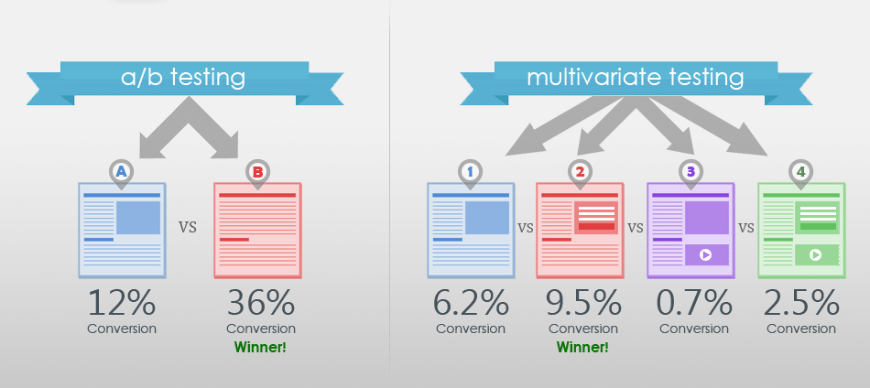
Multivariate testing - a useful follow up of a/b testing results

Slide 34
Multivariate testing
As the name suggests, more than one variable is changed at a time
This only works if you have a HIGH VOLUME of traffic and you already KNOW the DIRECTION you are heading towards AFTER successful A/B testing.
Example: Through A/B testing, we know that using phone calls as a channel leads to a higher conversion rate than emails alone.
Multivariate testing can be used to follow: through PHONE CALLS, we can try a COMBINATION of techniques , NOT JUST DIFFERENT WORDS, (e.g attitude, time of day, language used) to test the version with greatest impact.

Slide 35
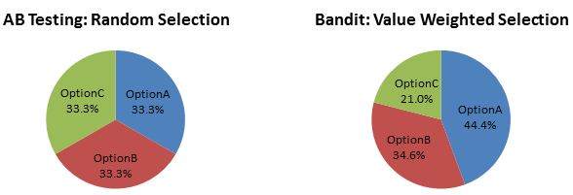
Bandit testing- learning in real time
Think of bandit testing like Machine Learning through a process much like a slot machine.
Instead of A/B/C/n, the tests are run based on an algorithm in real time, where the different variations are created, tested, kept and eliminated based on performance.
The algorithm updates based on “winning” variations and “losing” variations!

Slide 36
Key takeaways
On a daily basis, our minds are constantly doing a/b testing!
We are LEARNING constantly- what works ? what doesn’t?
How can we become more efficient, effective, and productive?

Slide 37
Key takeaways
To benefit the business as a whole however…

Slide 38
Key takeaways
We must not only actively TEST, but also remember to RECORD and SHARE!

Slide 39
Key takeaways
-Promotes better business alignment as a whole
-More people testing = more reliable results
-Sharing knowledge to grow as a whole
- Helps to comprehensively train and inform new employees
- Builds a reference of learnings for the whole company

